Slide 1
Software Quality block Source Code Management
Jan Kožusznik
jan.kozusnik@vsb.cz
http://www.kozusznik.cz

Slide 2
Goals
"Good one starts with making certain that all of your source code is safely locked down and no important source code is lost.”
Another goal is to help improve the productivity of tour entire team – it can import the quality of source code by helping to implement automated testing.
Provide traceability – one of the most important goal.

Slide 3
Principles
Code is locked down and can never be lost
Code is baselined, marking a specific milestone or other point in time.
Managing variants in the code should be easy with proper branching.
Code changed on a branch can be merged back onto the main trunk.
Source code management process are repeatable, agile and lean.
Source code management provides traceability and tracking of all changes.
Source code management best practices help improve productivity and quality.

Slide 4
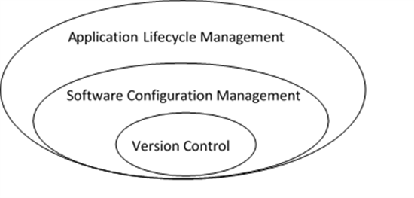
SCM
SCM is sometime referred as software configuration management and sometime source code management.
Software configuration management is more then source code management.
http://oneettn.tk/configuration-management-software/

Slide 5
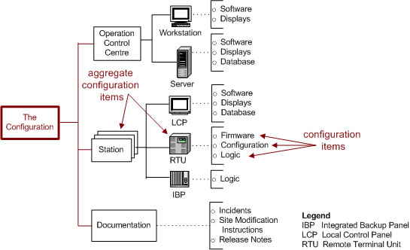
Configuration Item(s)
“Source code or another resulting artifact that make up the system” - Configuration Management (CM) terminology
http://www.chambers.com.au/glossary/configuration_item.php

Slide 6
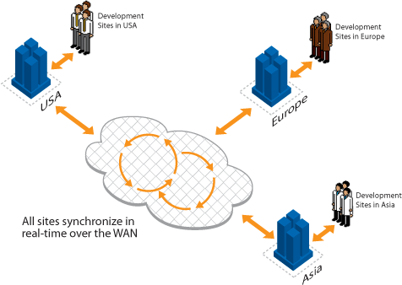
Why it is important
It gives the tools and processes to manage the configuration items.
http://blogs.wandisco.com/tag/distributed-version-control/

Slide 7
Core concepts creating baselines and time machines
Source Code Management is not only “check in”/”check out”.
Creating a baseline(tag) – identifying the exact versions of the code for a specif release. This operation has synonymous in CM tools – tagging, labeling, snapshotting.
Baselines need to be immutable.
Tag named “PRODUCTION” is “float” with current baseline of the code that is in production.

Slide 8
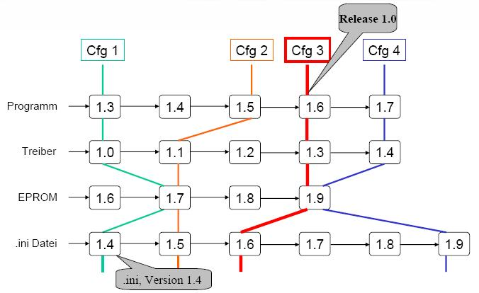
Core concepts baseline(tag)
https://wiki.enterpriselab.ch/edu/workspace:modules:swe:s08:deberli:arbeit

Slide 9
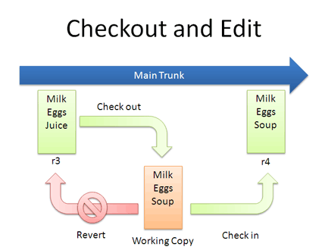
Check-in/check-out
Checkout:
  Reserved X unreserved
Check-in
Different tools may use different terminology: commit instead check-in.
2-phase commit (check-in)
Concept of a private sandbox (workspace) is widely spread.
http://betterexplained.com/articles/a-visual-guide-to-version-control/

Slide 10
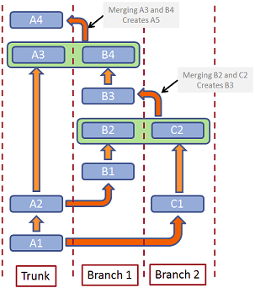
Variant management - branching
Main branch (often called trunk/main)
More working branches:
  Variants in code, different versions, working on bugfixes.
Copybranch vs deltabranch
http://www.codeproject.com/Articles/431125/Choosing-a-Version-Control-System-A-Beginners-Tour

Slide 11
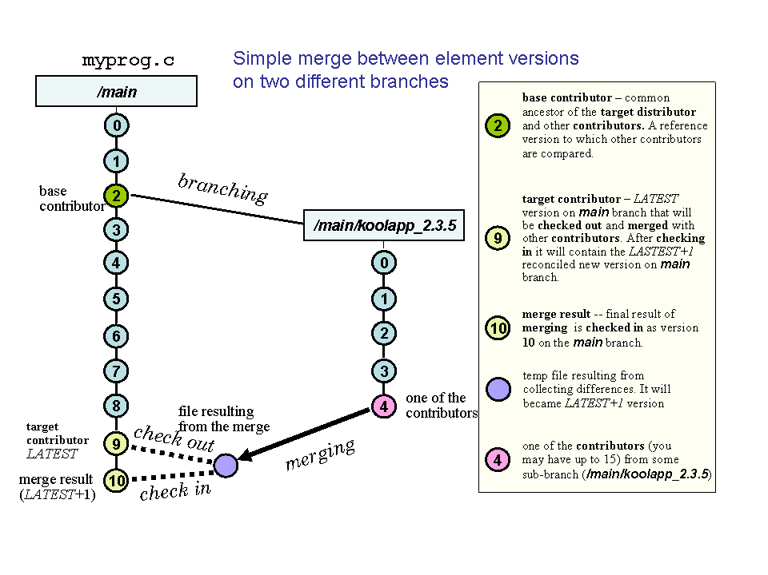
Merging
Required operation with using branches
Inner merge – from a branch to the main trunk.
Outer merge
http://www.ccl.net/cca/software/UNIX/clearcase/

Slide 12
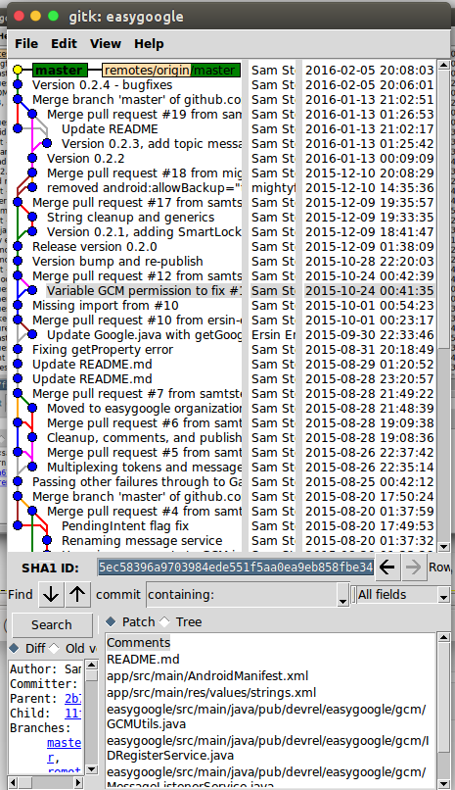
Changesets
A convenient way to group one or more modification to the codebase.
Checking in a changesets (called commiting) – atomic operation
Tracking defects and requirements to changests – key feature providing traceability

Slide 13
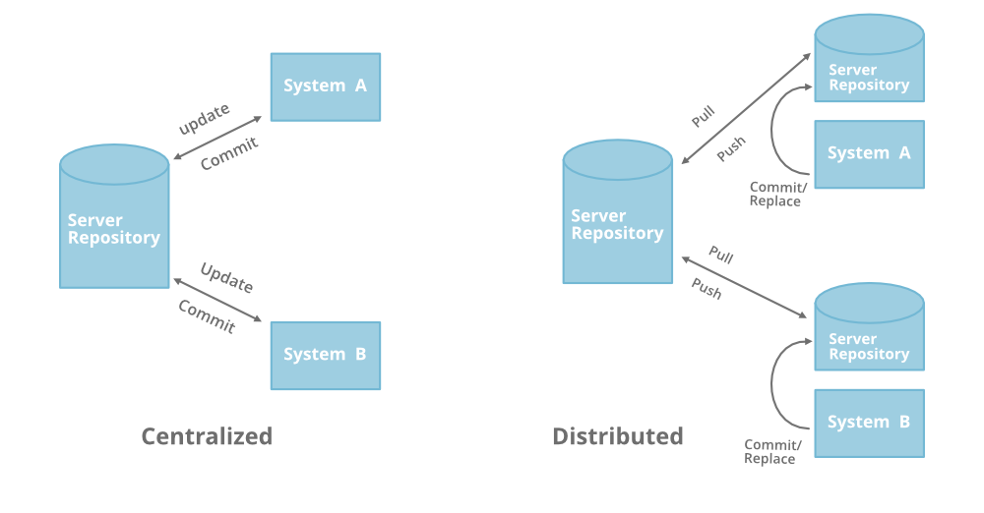
VCS (Version Control System)
CVS,
Svn,
ClearCase
git,
mercurial,
Bazaar
https://www.geeksforgeeks.org/centralized-vs-distributed-version-control-which-one-should-we-choose/

Slide 14
Get git repository
New repo
git init <directory>
Existing one:
git clone <url> [<directory>]

Slide 15
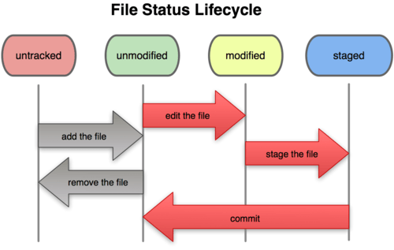
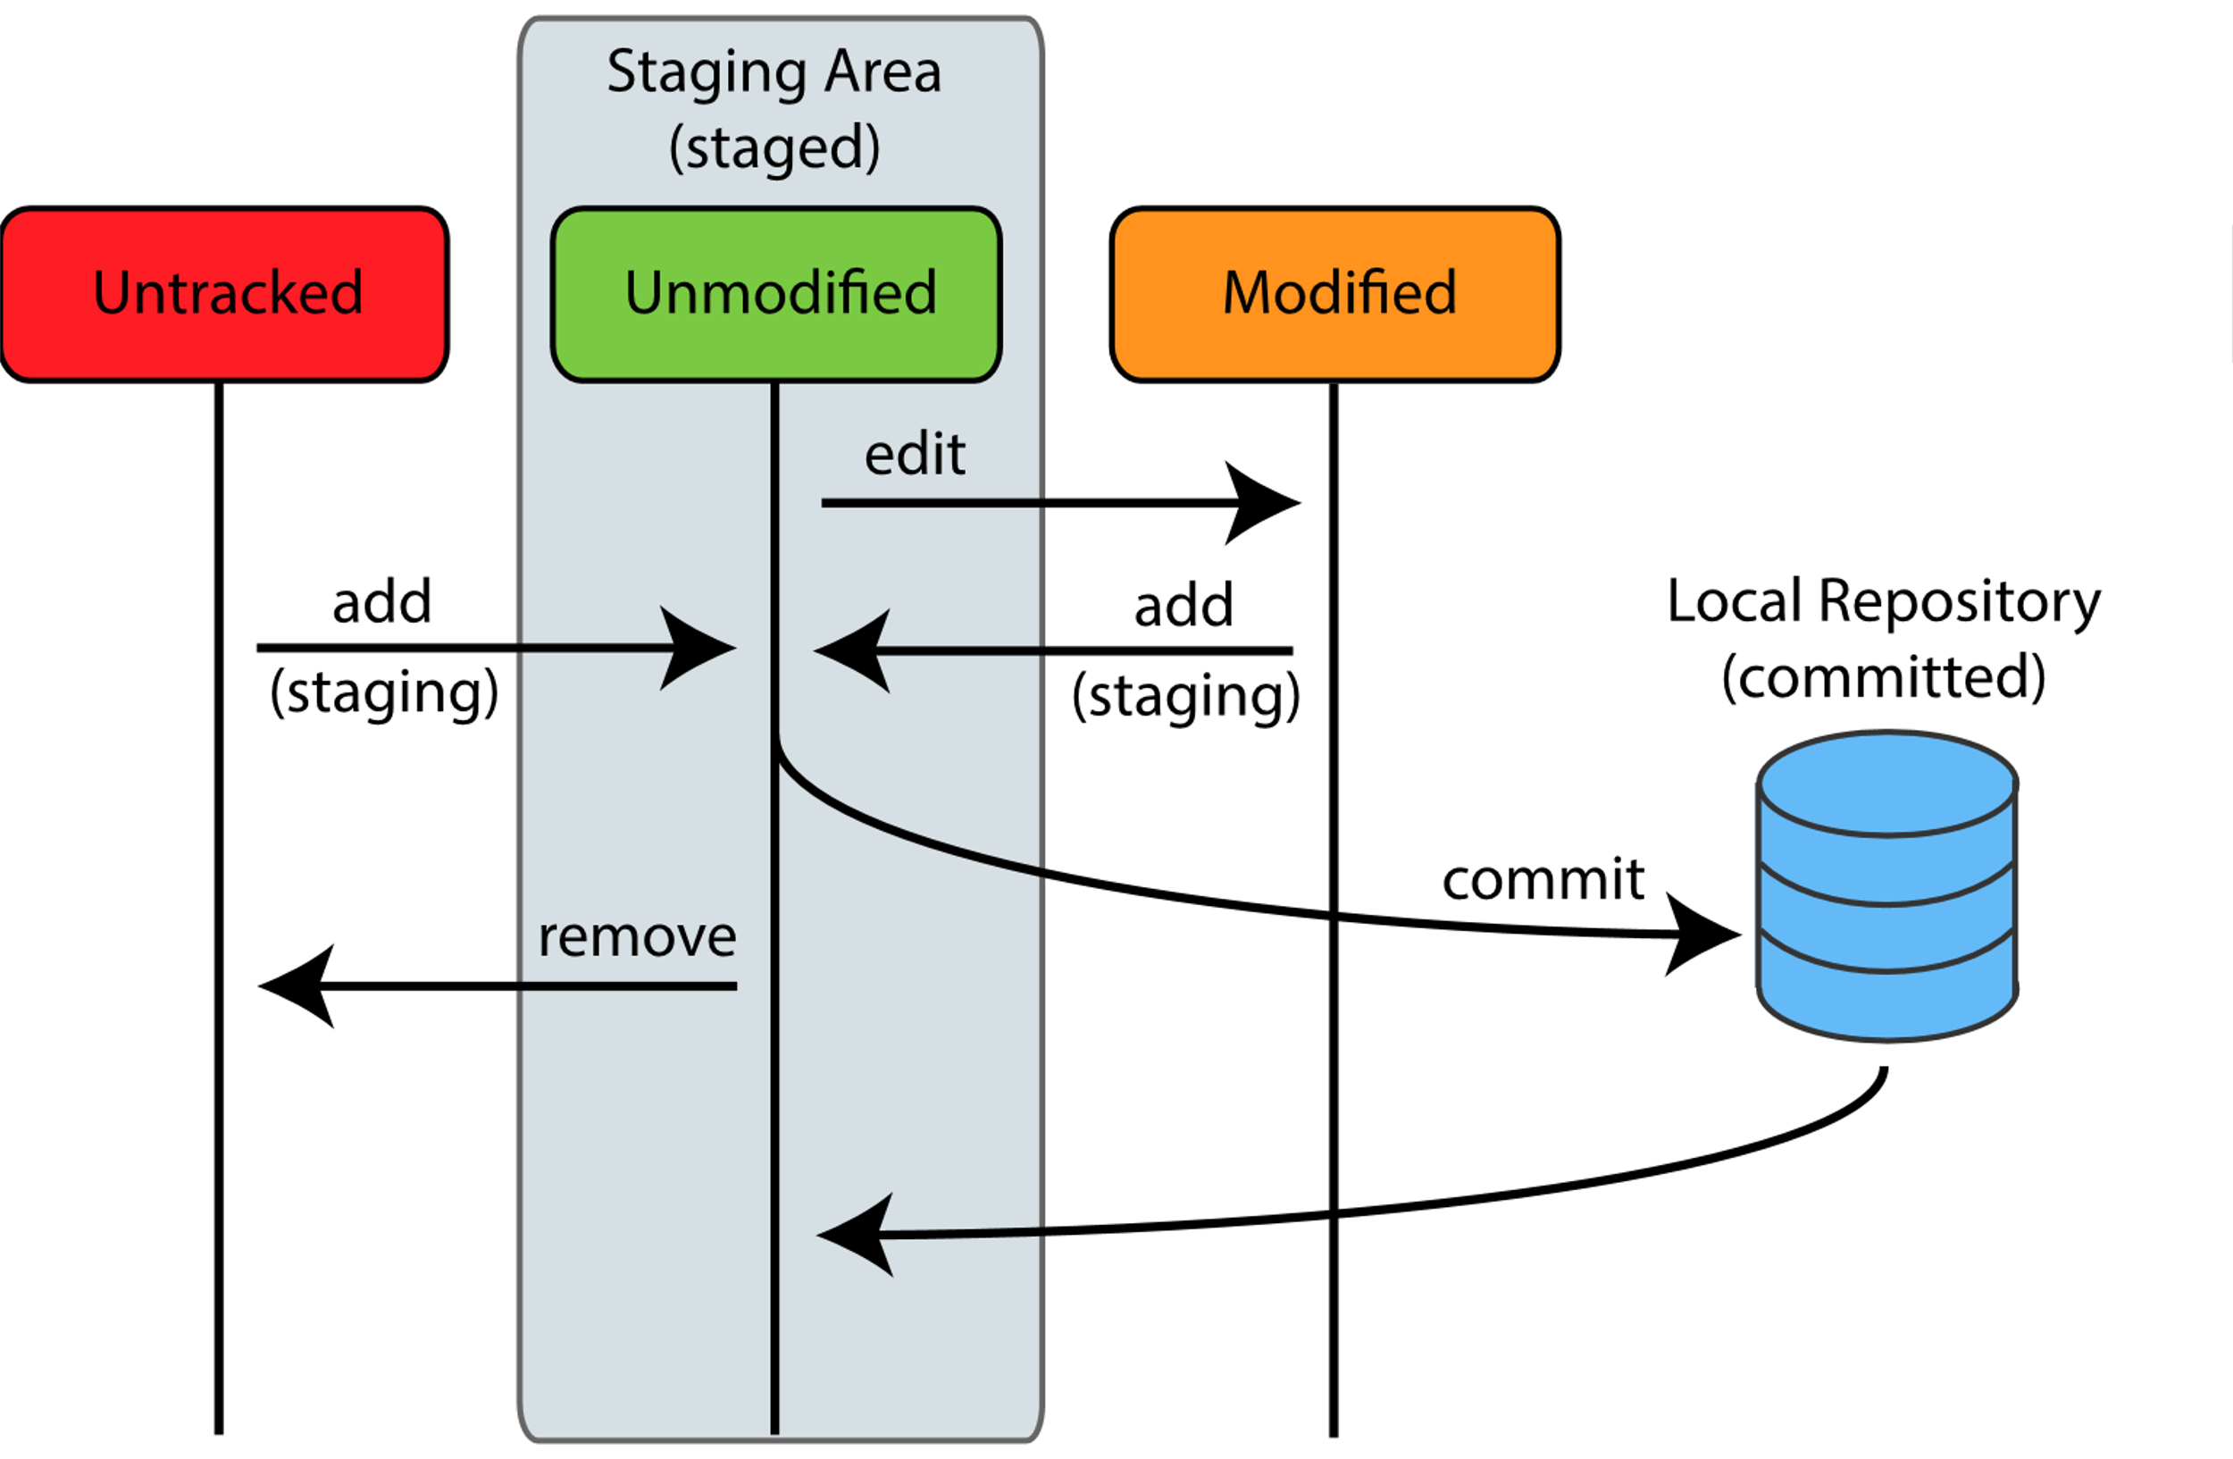
Basic git Operations
git add <path>
git commit

Slide 16
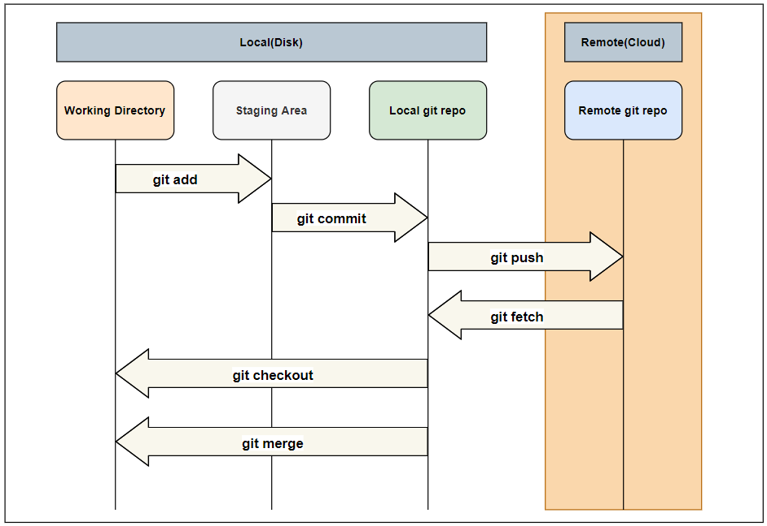
Parts of git repository
Notes:
M

Slide 17
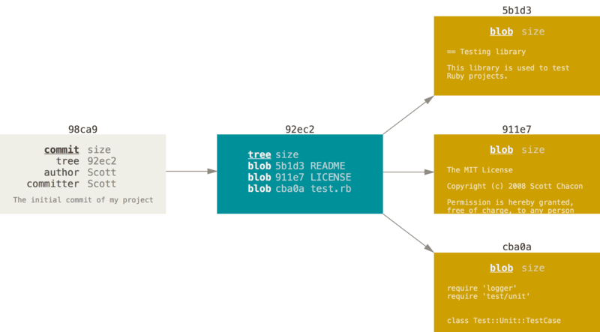
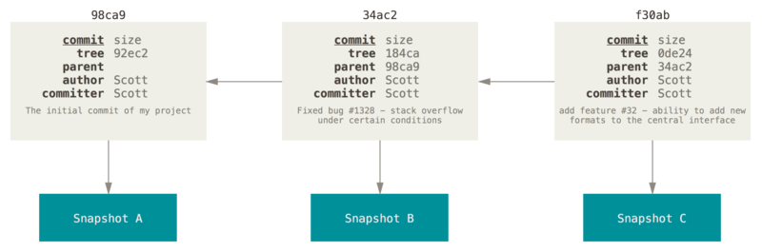
Git commit
A commit and its tree
Commits and their parents

Slide 18
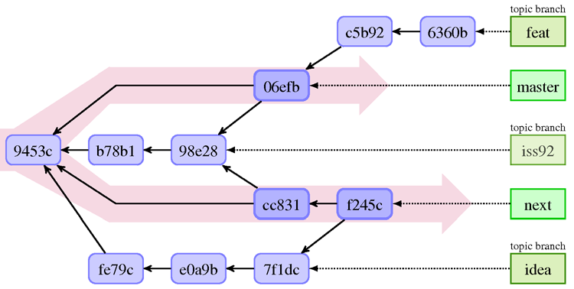
Git branching
Pointer for different commits
Default branch is “master”/”main”
Create new branch
  git checkout –b <branch name>
  git checkout <existing remote branch name>
Switch to different
  git checkout <existing branch name>
Show branches
  git branch –v

Slide 19
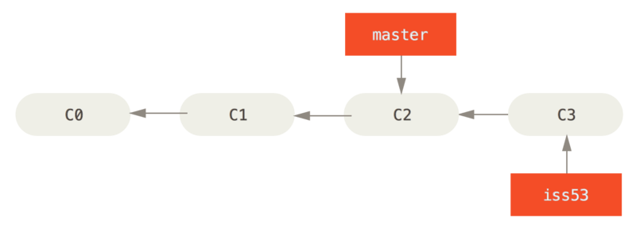
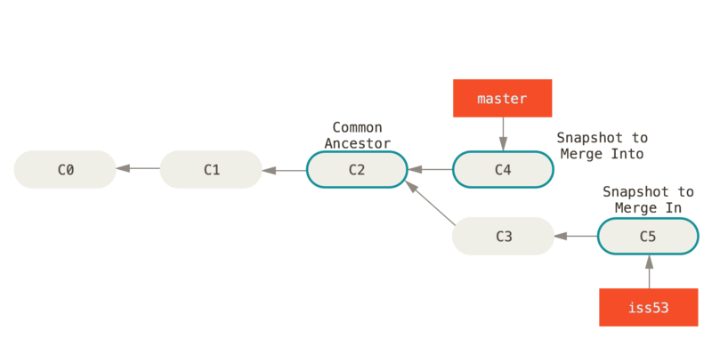
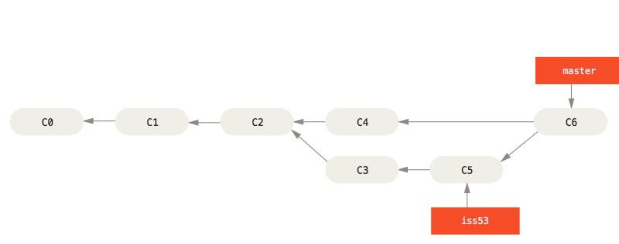
Merging
Fast-forward
No FF

Slide 20
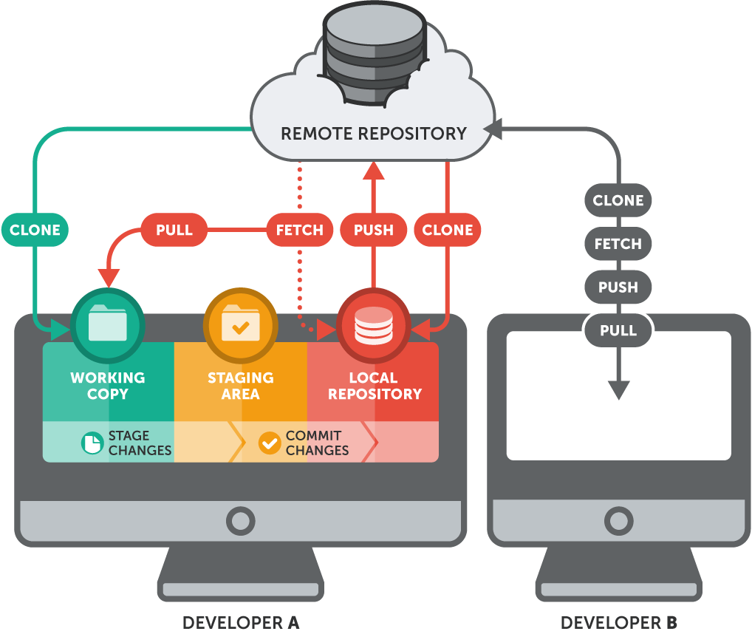
Remote repositories
Download existing
git clone <url>
Connect to remote repository
git remote add <remote name> <url>
Upload/download branch to/from remote repository
git push <remote name> <branch>[:<remote branch>]
git pull <remote name> <branch>
Set default upstream for branch
git push <remote name> <branch>[:<remote branch>] –u
git branch [<branch name>] --set-upstream-to=<remote name/remote branch>
git fetch/pull
git fetch… update remote branches from remote (git fetch –all .. from all remotes)
git fetch <remote> <branch> .. get only specific branch
git pull is:
git fetch
git merge <upstream remote branch>

Slide 21
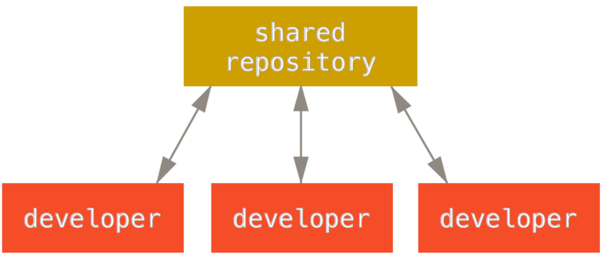
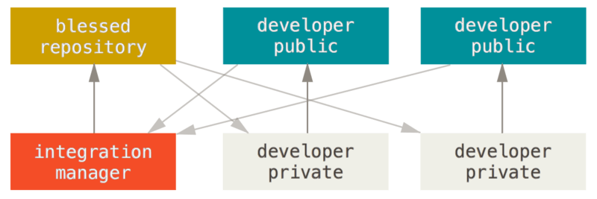
More remote repositories

Slide 22
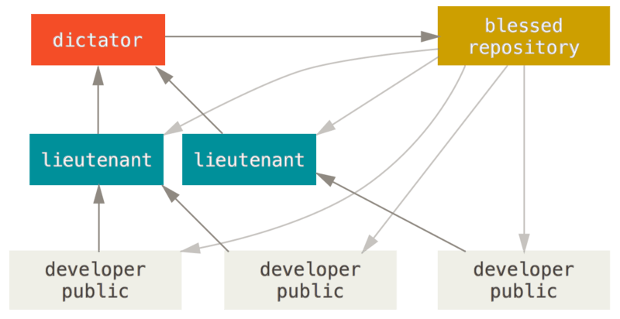
More remote repositories II

Slide 23

Rewriting history
Amend commit
Git reset
Rebase

Slide 24
Changing the Last Commit
Create new commit base on last commit with modification:
  message,
  changed files,
  …
Stage modified changes (git add )
git commit –amend [-m “<message>”]

Slide 25
git reset
1. Moving HEAD (and branch reference to)
git reset –soft <commit-id>
2. Updating index
git reset [--mixed] <commit-id>
3. updating working directory
git reset --hard <commit-id>

Slide 26
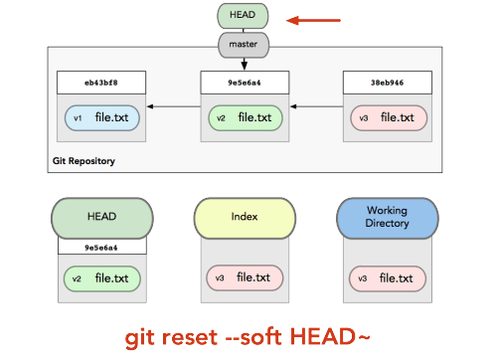
git reset --soft
stop after moving HEAD

Slide 27
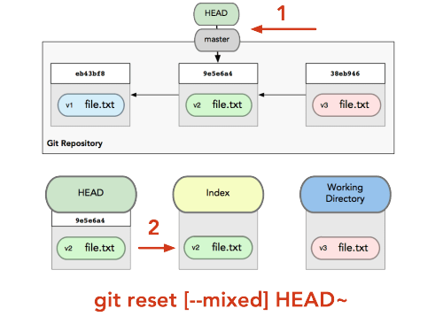
git reset [--mixed]
stops after updating index

Slide 28
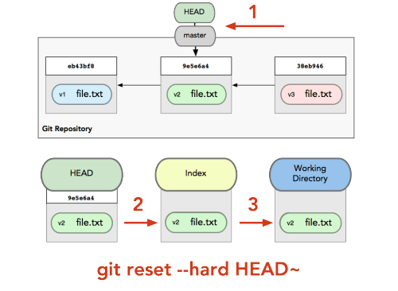
git reset --hard
does all steps (stops updating working directory)

Slide 29
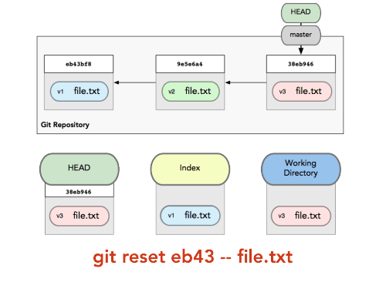
Reset with a Path
git reset <path>
  make the Index look like HEAD - unstage files
get reset <commitID> --<path>
  make the index look like

Slide 30
git checkout vs git reset
moves only HEAD but not reference branch
modified files are kept in working directory (could be replaced with -f or –force option)

Slide 31
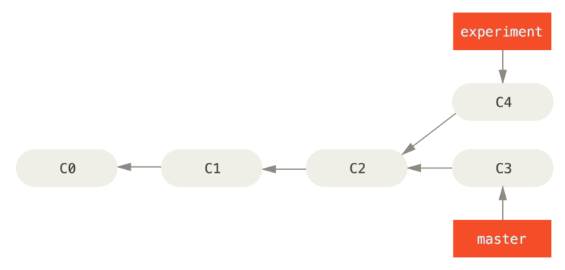
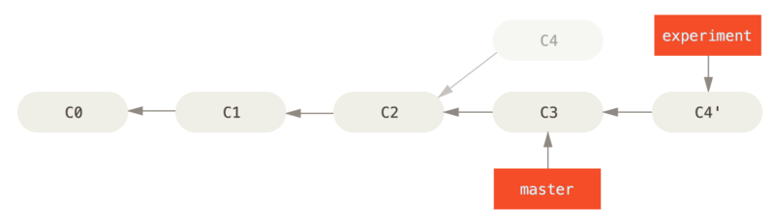
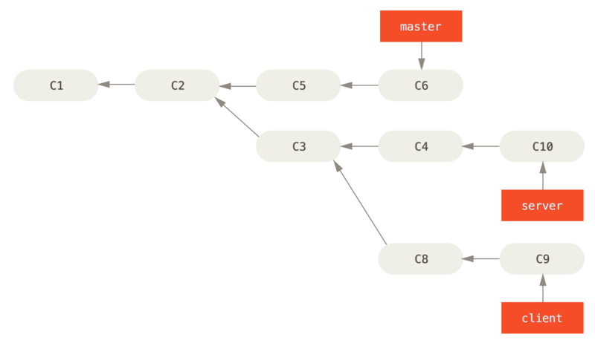
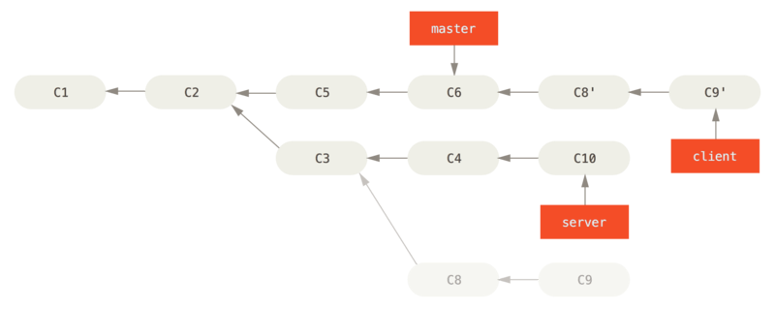
Rebasing
git rebase <commit-id> [<commit-id2>]
git rebase –onto <new-base> <old-base> <commit-id>

Slide 32
Interactive rebasing
git rebase <commit-id> --interactive|-I
Offers list of rebased commits to:
  pick
  reword
  Skip
  squash
  drop
  …
  can change order

Slide 33
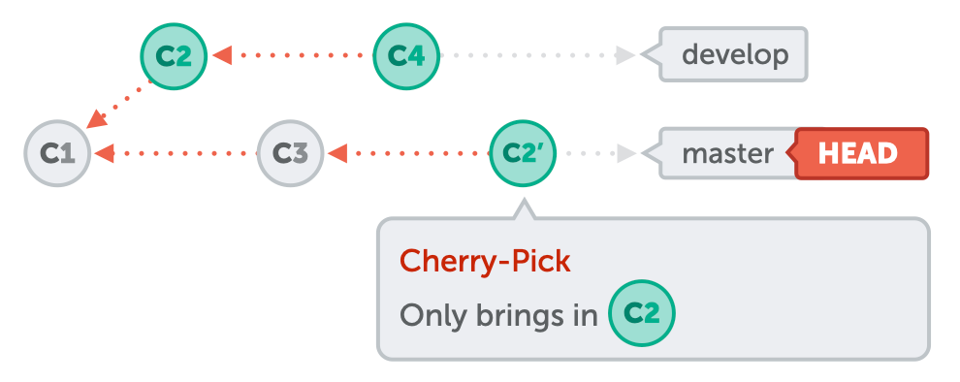
Other useful function
git stash
git rm [--cache] <files>
git tag
git cherry-pick <commit-id>

Slide 34
Symbolic commitIDs
HEAD
FETCH_HEAD
ORIG_HEAD
HEAD@{num}
git reflog
<branch/commit>~<num>
<branch/commit>^<num>

