Slide 2

Java
Jan Kožusznik
jan.kozusnik@vsb.cz
http://www.kozusznik.cz

Slide 3
Literature
Sun.The Java™ Tutorials., http://download.oracle.com/javase/tutorial/.
Oracle Academy: Course „Java Foundations“
Oracle Academy: Course „Java Programming“
SCHILDT, Herbert, 2018. Java: A Beginner’s Guide, Seventh Edition. 8 edition. New York: McGraw-Hill Education. ISBN 978-1260440218 .
SCHILDT, Herbert a Jakub GONER, 2016. Java 8: výukový kurz. 1. vydání. Brno: Computer Press. ISBN 978-80-251-4665-1.
Notes:
The first reference is tutorial made authors of JAVA – formerly Sun Microsystem but Oracle now. It is basic source and it is available also as textbook in Amazon shop – it is a second reference.
Third reference is legendary source about JAVA and it is complementary srource.
The last reference is good to understanding basics of object oriented paradigm in JAVA language.

Slide 4
1th lecture - objectives
Types, Operators, variables
Object type, class structure
Constructors
Overloading

Slide 5
Motivation for Java

Slide 6
Motto:
„Write once, run anywhere“
Sun Microsystem
Notes:
Every should have its motto. This is original motto of authors of JAVA. JAVA technology was developed according to it and we use this motto also in our classes.

Slide 7
Features of Java technology
Multiplatform and portable
Object Oriented
It has simple language – core is API
Robust, Dynamic and Secure
Multithreaded
Support for distributed application
Notes:
According to motto, compiled Java application could executed on various platforms (Windows, Linux, MacOS, FreeBSD, Solaris, ) without any modification. Java language has no aspect depended on target platform.
Java is fully object oriented. Every concept is object – primitive data types are only exception (integer, double …). It should improve the performance of applications.
Basic syntax of JAVA language is very simple in comparison with C++. A lot of operations and constructions is implemented as methods and classes in standard Java application programming interface.
Java platform provides features for creation of application that are more resistant against failures – good support of exception handling and keyword asser is an example.
Java also provides application programming interface (API) for encryption/decryption.
Java also provides application programming interface for running parts of program independently each to each other – it is running of program in more threads.
Java application could also consist of more then one parts running on different computer. Parts communicate through the network connection.

Slide 8
Data Types
Primitive types – only values:
  int is in [-2147483648, 2147483647 ]
  boolean is in {false, true}
  double is in [4.9*10⁻³²⁴, 1.7976931348623157*10³⁰⁸]
Object types – reference to instance of class:
  type from Java (more than 18000) – e.g. String
  defined by user – e.g. Rectangle

Slide 9
Primitive Types
Similar to C/C++ but:
  Types has exactly same size on every platforms
  All numeric types are signed
  boolean type is separate type and numeric types are not automatically converted in.
  Type for strings (String) is object type
Integer data types:
  byte (8b), short (16b), int (32b), long (64b)
    Their literals should contain ‘_’ …. 10_000
    long literals are defined with suffix l … 10l
Floating point (Real) data type
  float (32b), double (64b)
    float literals are defined with suffix f … 3.151f
Textual primitive type - char (16 b) – only single 16 bit Unicode character
Boolean type – boolean (1b)

Slide 10
Operators
Mainly for primitive types – exception is ‘+’ used for string concatenation and ‘[]’ used for arrays.
Like C:
  unary: +,-, ++,--
  binary: …, modulo % also available for double
  assignment: =, +=,-=, …
  relational: ==, !=, <=, … operands are values of some numeric type (integer or real) result is value of boolean type.
  logical: !, ||, && ,^ - operands and result are always values of boolean type
    available also non lazy version |, & - both operands are always evaluated
  ternary: <condition expression>?<value1>:<value2>
  bitwise:
  cast: () – automatic casting of value is allowed to a type that has bigger range(numeric primitive) or to parents (object)
Construct expression with defined precedence.

Slide 11
Object Type
An Object is an distinguishable entity that has:
  Identity: a uniqueness which distinguishes it from all other objects
  Behavior: services it provides to another objects
  State: value of attributes held by an object
A class is an abstraction of objects with similar implementation
  Class is definition of set of similar objects
  Every object is an instance of one class

Slide 12

Object is an instance of a class
Reference to the instance is stored
Instance of class Rectangle is created.
Rectangle rectangl1 = new Rectangle(); //an object creation
Identifiers - name variables, functions, classes, and objects - anything that programmers need to identify and use. Identifiers start with letter, underscore or dollar sign and they are
case-sensitive. More about convention:
http://java.sun.com/docs/codeconv/html/CodeConvTOC.doc.html

Slide 13

Object responds to a message call
Methods are called on object only by ‘.’ (not by -> )
Message on the instance could be sent.
rectangle1.moveDown();

Slide 14
Attributes
State of an object is based on value of its attributes.
State is modified by methods (ideally)
Rectangle (0x01b13400)
Rectangle (0x01b13401)
x
5
x
45
y
15
y
80
width
20
width
20
height
15
height
25

Slide 15
Reference vs. instance
Another instance is created only by operation new.
Reference to the same instance is passed during assignment.
Rectangle rectangl1 = new Rectangle();
rectangl1.moveDown();
//...
Rectangle rectangl2 = rectangl1;
Rectangle (0x01010000)
Rectangle (0x01010000)
Identifiers refers the same instance.
Only reference is assigned.

Slide 16
Comparing Variables (values)
When you compare values by using boolean expressions, you need to understand the nuances of certain data types.
Relational operators such as == are …
  Great for comparing primitives
  Terrible for comparing Strings (and other objects)
© Oracle Academy - Java Foundations

Slide 17
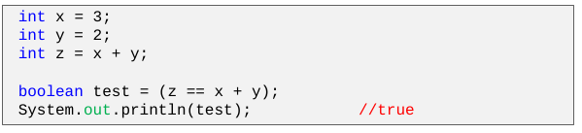
Comparing Primitives
The value z is set to be the sum of x + y.
When a boolean expression tests the equality between z and the sum of x + y, the result is true.
© Oracle Academy - Java Foundations

Slide 18
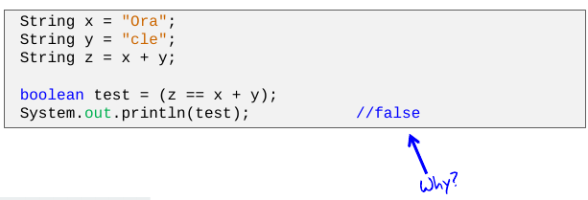
Comparing Strings (true for objects)
The value z is set to be the concatenation of x + y.
When a boolean expression tests the equality between z and the concatenation of x + y, the result is false.
© Oracle Academy - Java Foundations

Slide 19
Why Are There Contradictory Results?
Primitives and objects are stored differently in memory.
  Strings are given special treatment.
  This is discussed later in the course.
As a result ...
  == compares the values of primitives.
  == compares the objects’ locations in memory.
It’s much more likely that you’ll need to compare the content of Strings and not their locations in memory.
© Oracle Academy - Java Foundations

Slide 20
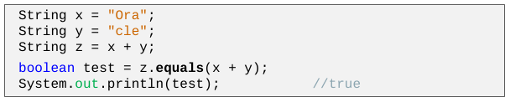
How Should You Compare Strings?
You should almost never compare Strings using ==.
Instead, compare Strings using the equals() method.
  This method is part of the String class (part of every class).
  It accepts one String argument, checks whether the contents of Strings are equal, and then returns a boolean.
  There is also a similar method, equalsIgnoreCase()
© Oracle Academy - Java Foundations

Slide 21
Variables
Again similar to C/C++ (instance, local, static, methods arguments) except:
  There is no global variable – every declaration should be placed inside class or their methods or other blocks
default value depends on data type and variable type (local, instance, static) – local variables need explicit definition of initial value

Slide 22
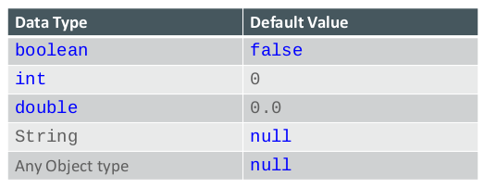
Accessing Uninitialized Variables
If variables aren’t initialized, they take on a default value.
Not true for local variables!!!!!
Java provides the following default values:

Slide 23
Defining constants
variable with modifier final– its value cannot be changed
It is good practice to define variable as final when it is not changed in the future.
Instance variable needs to be initialized in a constructor or by default value during declaration.

Slide 24
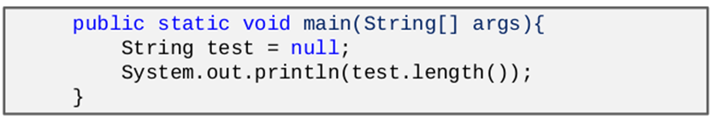
Null Object reference
Variables of object type can have a null value.
A null object points to an empty location in memory
If an Object has another Object as a field (such as a String), its default value is null.
What if a null object contains a field or method that needs to be accessed?
  This causes the program to crash!(It is possible to handle it!)
  The specific error is a NullPointerException.

Slide 25
Java Classes in Source Code

Slide 26
Definition of class
Every class have to be within own source file named “<class-name>.java” - following class Person is in file Person.java.
Name of class should follow conventions -
Name should be noun, in mixed case with the first letter of each internal word capitalized.
All class definitions are inside class block ({})
Visibility modifiers(public, private, protected) should be placed before every defined element.

Slide 27
Structure of a Class
public class Person{
private Calendar birthDay;
private int actualIq;
public Person() {
this(Calendar.getInstance());
}
public Person(Calendar aBirthDay) {
this(aBirthDay, 110);
}
public Person(Calendar aBirthDay, int aIq) {
birthDay = aBirthDay;
actualIq = aIq;
}
public void run(int maxSpeed) {
//process of running
}
private int getActualAge() {
int result;
//computation of age
return result;
}
}
Notes:
Value is assigned only once:
during declaration – class and instance attribute, local variable;
in a constructor - instance attribute;
during the method call – parameters.
<number>

Slide 28
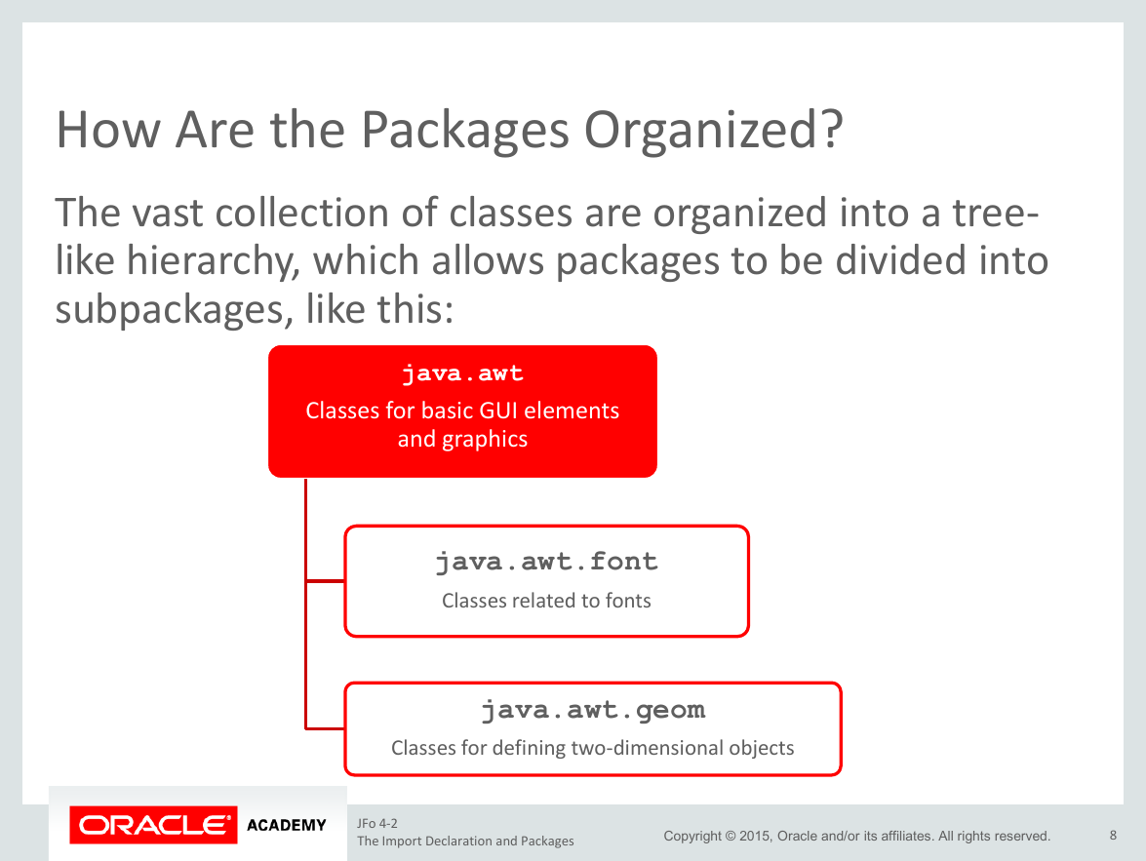

Slide 29
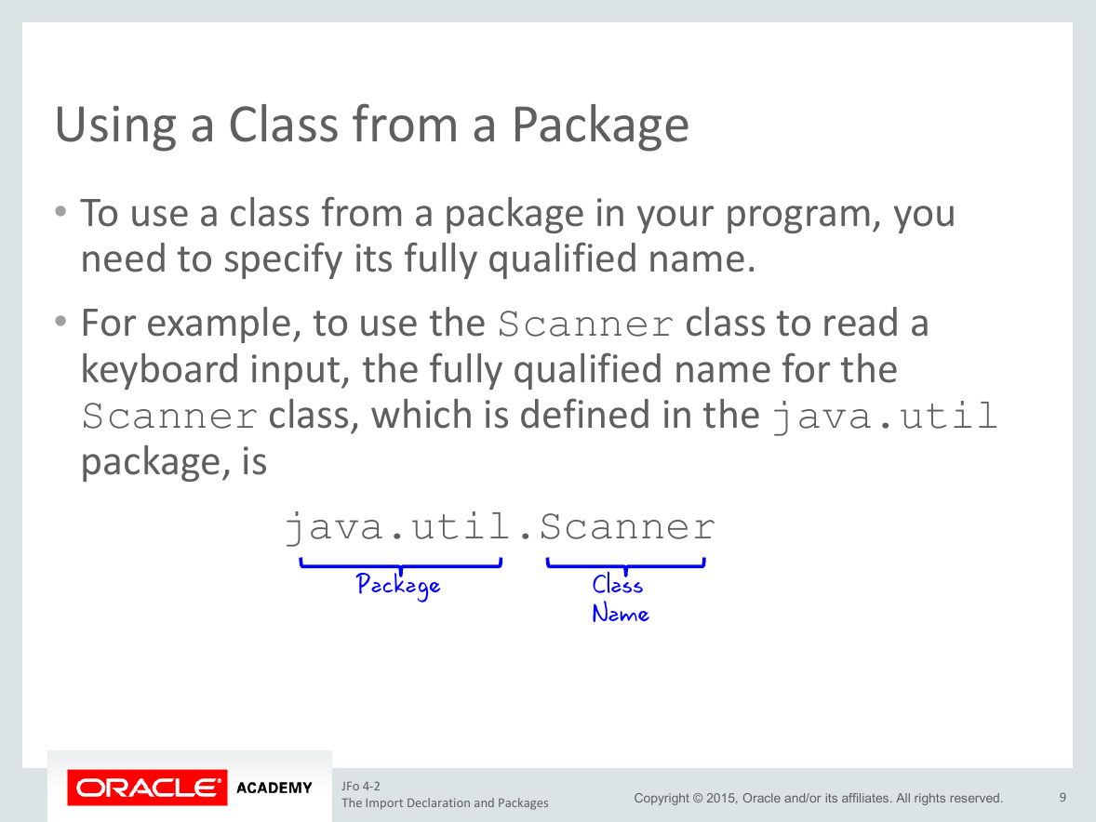

Slide 30
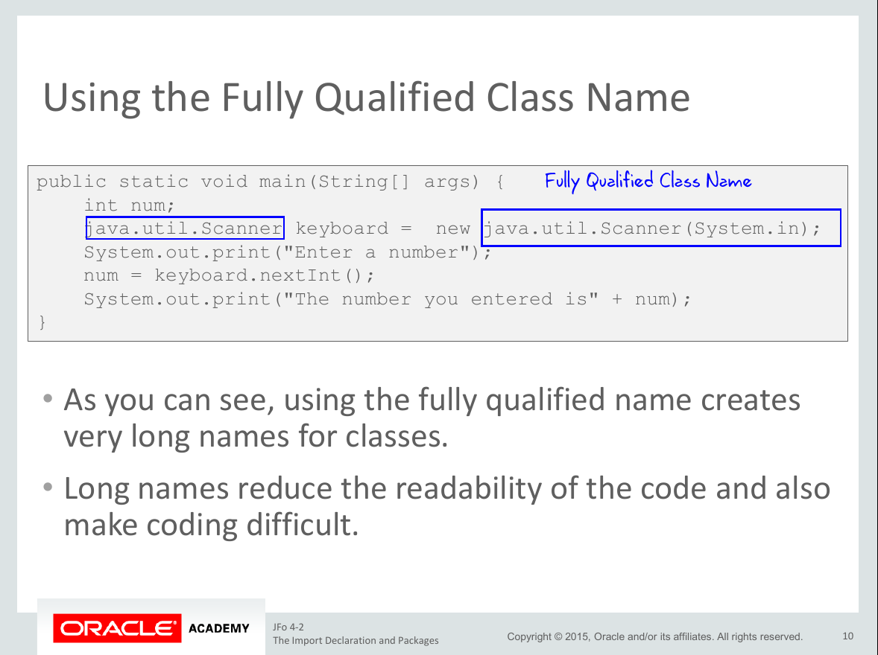

Slide 31
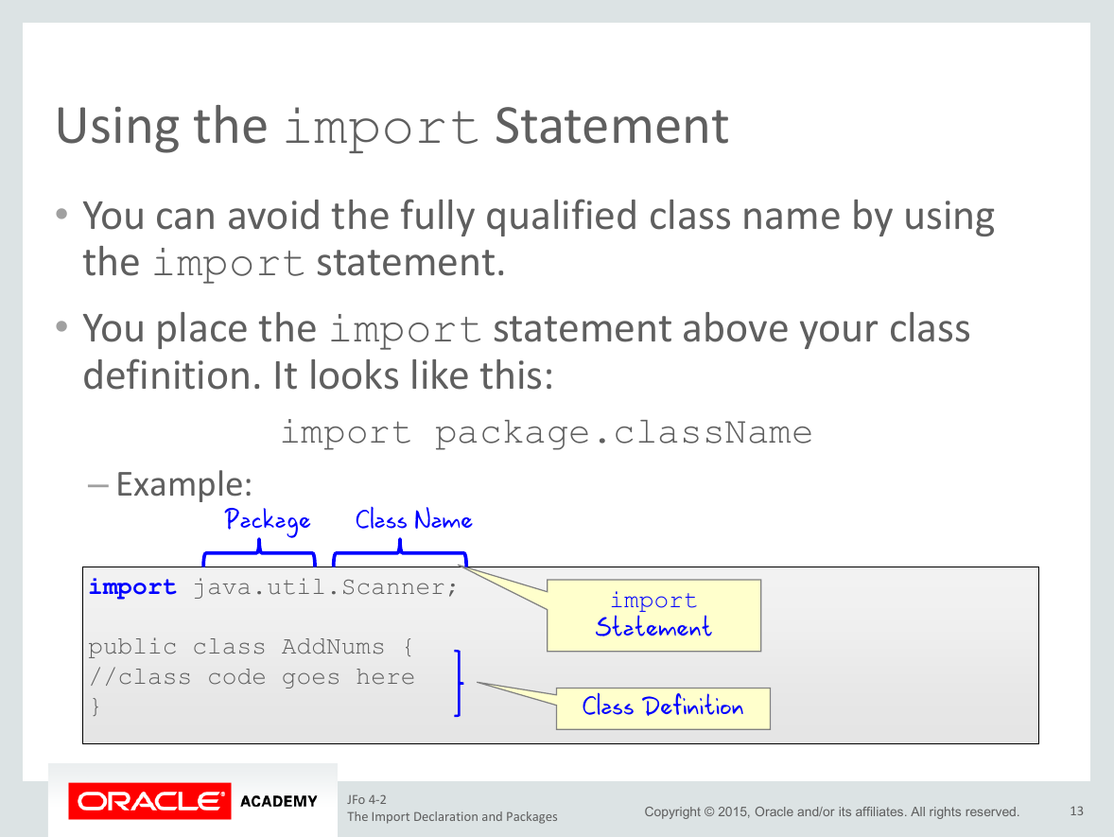

Slide 32
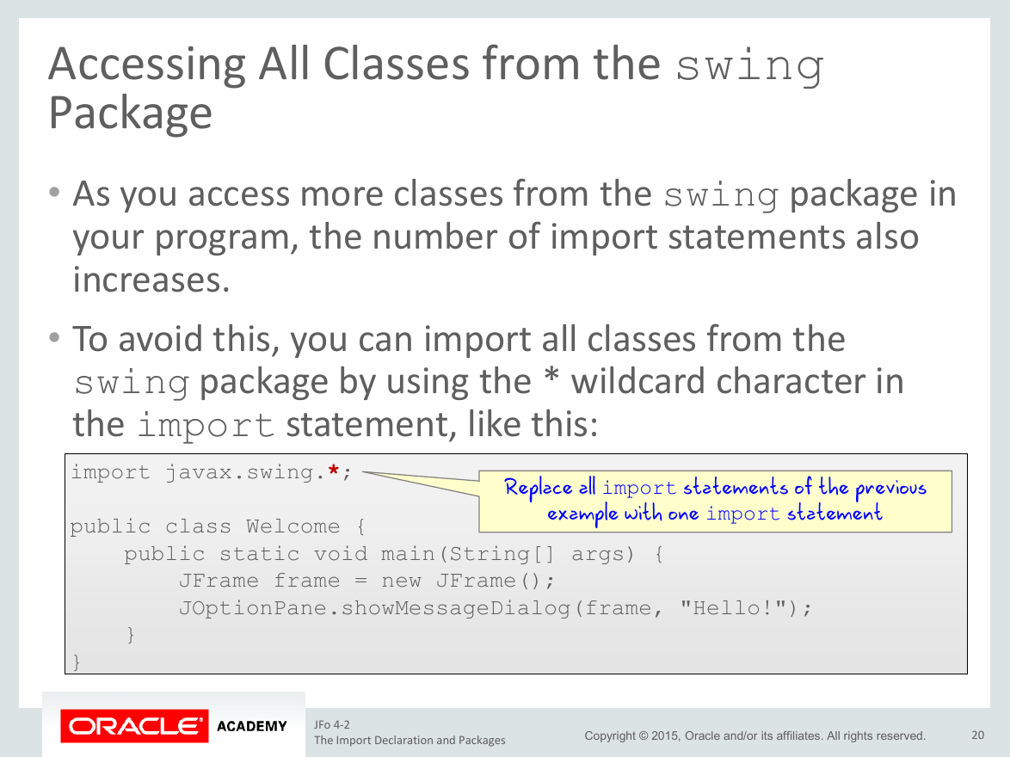

Slide 33
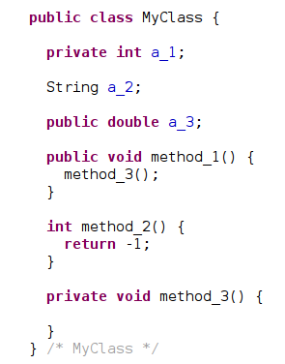


Visibility modifiers
They are used with:
  variables – both instance and class
  methods
  ...and also classes!
access | public | protected | <none> | private
the same class
the same package
successors
anywhere

Slide 34
Overloading Constructors
You can write more than one constructor in a class.
  This is known as overloading a constructor.
  A class may have an unlimited number of constructors.
Each overloaded constructor is named the same.
But they differ in any of the following ways:
  Number of parameters.
  Types of parameters.
  Ordering of parameters.

Slide 35
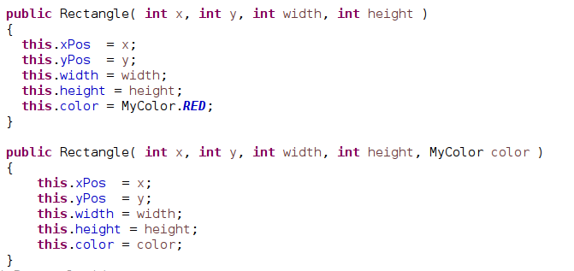
Recognizing Redundancy in Constructors
Very similar code is repeated in these constructors.
It’s possible to minimize this redundancy.

Slide 36
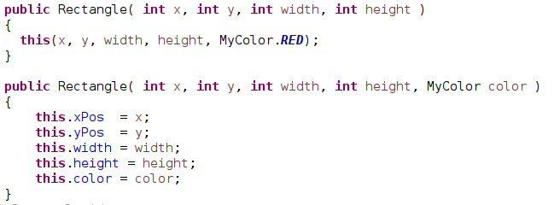
Constructors Can Call Other Constructors
By using the this keyword, one constructor may call another.

Slide 37
Overloading Methods
Any method can be overloaded, including ...
  Constructors
  Methods that model object behaviors
  Methods that perform calculations
All versions of an overloaded method are named the same.
But differ in any of the following ways(in a signature of the method):
  Number of parameters
  Types of parameters
  Ordering of parameters
Which version of overloaded methods is chosen during compilation – important when we use object types and inheritance.

Slide 38
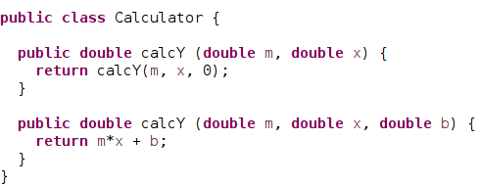
Methods Can Call Other Methods in the Same Class
In this example, one method returns a value to the other.

Slide 39
2nd lecture
Basic OOP
  Interface
  Inheritance
  Method overriding
Scanner class
Nested (Internal) class

Slide 40
Interface
An interface is a Java construct that helps define the roles that an object can assume – it allows treat with objects of different classes uniformly
It is implemented by a class or extended by another interface.
An interface looks like a class with abstract methods (no implementation), but we cannot create an instance of it.
Interfaces often define collections of related methods without implementations.
All public methods in a Java interface are abstract (or default using another methods in the interface).
Notes:
A

Slide 41
Why Use Interface
When implementing a class from an interface we force it to implement all of the abstract methods.
The interface forces separation of what a class can do, to how it actually does it.
So a programmer can change how something is done at any point, without changing the function of the class.
This facilitates the idea of polymorphism as the methods described in the interface will be implemented by all classes that implement the interface.

Slide 42
Interface properties
An interface:
  Can declare public constants.
  Define methods without implementation, default method, private methods or static method.
  Can only refer to its constants and defined methods or other accessible methods (static or methods of objects passed as parameter).
  Can be used with the instanceof operator.
A class
  can implement more then one interface
An interface method
  Each method is public even when you forget to declare it as public – private methods are exception.
  Is implicitly abstract but you can also use the abstract keyword.
  Each variable is public final static – even without modifier.

Slide 43
Declaring Interface
To declare a class as an interface you must replace the keyword class with the keyword interface.
This will declare your interface and force all methods to be abstract and make the default access modifier public.
public interface Paintable {
int DEFAULT_SIZE = 10;
void paint(MyGraphics d);
}

Slide 44
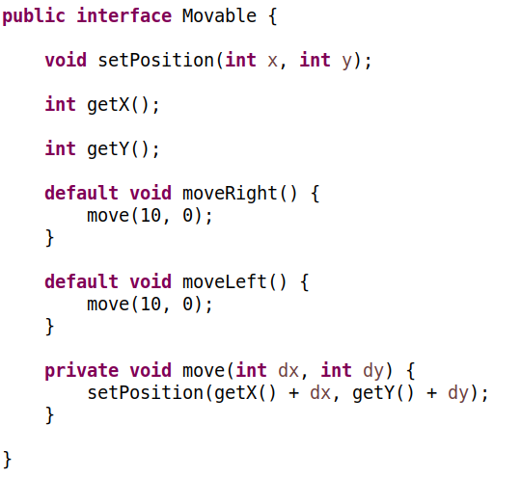
Default (since Java 8) and private(since Java 9) methods
These methods can not deal with inner structure
Help remove redundancy in code and extend existing interface

Slide 45
Interface Implementation
public class Rectangle implements Paintable
{
//...
@Override
public void paint(MyGraphics d) {
//...
Class declares implementation of specified interface.
It has to implement every method of specified interface.
Notes:
Class declares interface implementation with keyword “implements” and it should implement every method declared in an interface with exactly same signature. Every method declared in an interface is public visible and so implemented methods should be also public visible.
Mark @Override should be used before implementation of the specific method.
<number>

Slide 46
Multiple Interface implementation
Every class could implement more then one interface.
When are implemented two or more interfaces with same default methods then these methods should be overridden. It could call one of the existing implementations.
public class Rectangle implements Paintable, Clear
{
public class MyClass implements Movable, Pickable{
@Override
public void moveRight() {
Movable.super.moveRight();
}
Notes:
Similarly as we could posses more licenses – driving, diving etc. – a class could also implements more interfaces.
Visible shapes could be paintable – their class implements interface Ipaintable -and also they could be hidden – their classes implements interface IClear.
The interface “IClear” declares a method hide – implementing classes should implement it in advance.
Question: What if an implemented interfaces declares same method? Answer: Class implements the method only once.
<number>

Slide 47
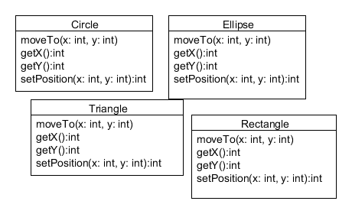
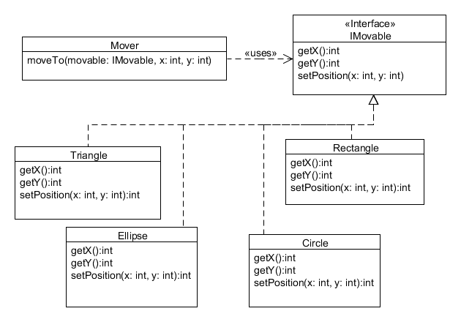

Design pattern Template method
Common logic is placed externally of class.
Class is accessed through defined interface.
Notes:
This design pattern is know also as “Command”. Principle of the pattern is that common logic – method “moveTo” for fluent moving in our case - is outside of the class as is Rectangle or Circle.
This method has really similar implementation aspects in all of these classes – base on an actual and a final position of an object it fluently moves (it repeat calling of the method setPosition) to the object.
New class Mover is created with one method moveTo. This method as parameters obtains an object to move and the final position to move.
The object only has to implement interface – methods declared in it. These method is class – specific and the class implements them also for another purposes.
<number>

Slide 48
Design pattern Template method in source code
Common behavior is in a separate class
public class Mover
{
private static final long SLEEP_TIME_IN_MS = 500;
private static final double SPEED = 10;
public void move( IMovable object, int toRight, int toDown )
{
double distance = Math.sqrt(toRight*toRight + toDown*toDown);
int STEPS = (int)(distance / SPEED);
double dx = (toRight+.4) / STEPS;
double dy = (toDown +.4) / STEPS;
int xPos = object.getX();
int yPos = object.getY();
double x = xPos + 0.4;
double y = yPos + 0.4;
for(int i=STEPS; i > 0; i-- )
{
x = x + dx;
y = y + dy;
object.setPosition( (int)x, (int)y );
Thread.sleep(SLEEP_TIME_IN_MS);
}
}
}
The algorithm – behavior will be applicable on any object that implements a specific interface
public interface IMovable {
int getX();
int getY();
void setPosition(int x, int y);
}
Notes:
A servant object should be used again and again in programs on objects that are instances of various classes. These classes hadn’t even existed when the class of the servant object was created. Classes of these object only should to implement defined interface.
<number>

Slide 49
Interface extension
If class implement the interface IMovable than it must also implement interface IPaintable.
IMovable extends IPaintable
public interface IMovable extends IPaintable{
Notes:
An implementation of an interface could depend on implementation of another interface. It means that if a some class implements one interface it should also implement another interface. It is again similar to licenses – a possessment of one license is conditioned b possessment of an another license.
For example, if one object is movable (implements the interface IMovable) it should be also paintable (implements the interface IPaintable) – it will be used in mover.
An interface(IFace2) that should be also implemented if a some class implements another interface(IFace1) is in java terminology extended by the interface (IFace2).
Definition of extension is in the interface that extends other one. Syntax is that after the name of the extending interface follows keyword “extends”
and follows name of extended interface.
Interface could extend more then one interface. Alee extended interfaces are specified in definition and they are separated by a comma.
Relation extends between interfaces is transitive.
<number>

Slide 50
Interface extends multiple interfaces
Interface can extend from multiple interfaces.
When are extended two or more interfaces with same default methods then these methods should be overridden as default - it could call one of the existing implementations (similar to implementation) – or leave them as abstract.

Slide 51
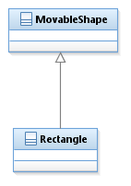
Class extension - inheritance
Rectangle is specialization of MovableShape.
MovableShape is generalization of Rectangle.
Rectangle is subclass(successor) of MovableShape.
MovableShape is superclass(predecesor) of Rectangle.
Notes:
Inheritance is in my humble opinion wrongly defined as one of the basic feature of object oriented paradigm. It is often incorrectly used in situation where another concept should be used – composition mentioned later or interfaces.
Inexperienced programmers try to use inheritance to avoid duplicities in source code or to re-use existing code.
How to avoid duplicities and reuse code, we have already presented with design pattern servant.
However, an inheritance could be useful. It allows to move common behavior that is result of common structure into one class. The class is common predecessor of the sub-classes. They should be real specialization of the super-class. It means that they could be fully applicable in every place where is applied super-class.
<number>

Slide 52
Inheritance in Java
Class could inherit only from one another class in Java.
If a superclass is not specified than class inherits from class Object.
public class Rectangle extends MovableShape
Notes:
Inheritance in JAVA is limited only to one class – every class should extends one class. It is enough in my humble opinion. I haven’t already solved problem where the multiple inheritance were necessary. Multiple inheritance is always caused by bad software design.
An inheritance relation is defined in successor. After name of class that extends some class follows keyword “extends” and name of extended class (predecessor).
Inheritance in JAVA causes in class that extends:
every public accesible attribute from predecessor is also in the successor
every public accesible method from predecessor is also in the successor
every implemented interface by a predecessor is also implemented by a sucessor.
Inheritance is transitive – if class A extends B and B extends C then A indirectly extends C. Class A could be casted to class C and contains all public accessible attributes and methods.
If no class extended class is specified then the class extends class “Object”. It is common parent for all classes and that is the reason why every object could by casted to the type Object.
<number>

Slide 53

Inheritance of constructors
class ParentClassType {
private int parentValue;
public ParentClassType() {
parentValue = 10;
}
public ParentClassType(int value) {
parentValue = value;
System.out.println("Parent constructor called");
}
}
public class ClassType extends ParentClassType{
}
Only default non-parametric constructor is available in this case.
new ClassType();
Constructors are not inherited in successors.
new ClassType(10);
Notes:
If child class doesn’t contains definition of any constructor than default non-parametric constructor is available but non-parametric constructor has to be available in parent class.
<number>

Slide 54
Implicit calling of predecessor constructor
Non-parametric constructor of predecessor (ParentClassType) is implicitly called at the beginning of object construction
class ParentClassType {
private int parentValue;
public ParentClassType() {
System.out.println(“Parent constructor called ”); +
}
public ParentClassType(int value) {
System.out.println(“Parent constructor called ” +
“with value + ” value);
parentValue = value;
}
}
public class ClassType extends ParentClassType{
private int value;
public ClassType() {
System.out.println(“Child constructor called ”);
value = 0;
}
public ClassType(int value) {
System.out.println(“Child constructor called ”);
this.value = value;
}
}
Both:
new ClassType();
and
new ClassType(10);
Produces output
Parent constructor called
Child constructor called
C:\>
Notes:
It is also possible to define constructors in child class. There is implicitly called non-parametric constructor of the parent in the begging of these child constructors.
Implicit calling of parent non-parametric constructor is possible only if this constructor is available in parent.
Q: When is non available non-parametric constructor? A: When there are defined some parametric constructors without explicit definition of non-parametric one.
<number>

Slide 55
Explicit calling of predecessor constructors
Explicit call of a specific parent constructor is by keyword super in child constructor. It has to be first statement in constructor of child.
class ParentClassType {
private int parentValue;
public ParentClassType(int value) {
parentValue = value;
}
}
public class ClassType extends ParentClassType{
private int value;
public ClassType() {
super(7);
value = 10;
}
public ClassType(int value) {
super(7);
this.value = value;
}
}
Notes:
We could explicitly call specific constructor in parent class from constructor of child class. Called constructor could contains useful implementation that should be used.
Call of parent constructors is:
By keyword “super” followed with parameters in parenthesis “()”
First statement in a child constructor
It is not possible to reference methods or attributes of already constructed instance before parent constructor calling – we cannot pass attributes as parameters during calling of parent constructor.
The reason is that instance is not constructed before calling of the parent constructor.
<number>

Slide 56
Instance building
class ParentClassType {
private int parentValue;
public ParentClassType() {
}
public ParentClassType(int value) {
parentValue = value;
}
}
public class ClassType extends ParentClassType{
private int value;
public ClassType() {
this(10);
}
public ClassType(int value) {
this(value, 7);
}
public ClassType(int value, int parentValue) {
super(parentValue);
this.value = value;
}
public ClassType(String anotherValue) {
System.out.println("Child constructor called with value "
+ anotherValue);}
}
If this(…) or super() are used, then it should be first statement in constructor. Otherwise nonparametric constructor of predecessor is called.
Notes:
Actually in a constructor, it could be call a constructor from the actual class or a parent constructor. Full process of construction is:
Another constructors are called by keyword “this” with list of parameters
last constructor which doesn’t call another constructor (with keyword “this”) calls parent constructor – implicitly or explicitly
after return from parent constructor is constructed instance available by keyword “this”
Instance attributes are initialized – (from the top to the bottom)
a body of constructor is executed – one by one as they were called
<number>

Slide 57
Disadvantage of inheritance
It breaks encapsulation principle
it is necessary to know details of implementation in super-class.
Composition is preferred.
Notes:
Inheritance has to be used very carefully because it breaks principle of encapsulation. Child class could access to protected elements and it could override public and protected elements. This implementation has to be done with knowledge and respect of implementation of a parent class.
Examples of badly used inheritance: Clout is extension of Ellipse.
Properly used inheritance: Circle is specialization of Ellipse.
<number>

Slide 58
Method overriding
Method redefined in successor are marked with annotation @Override.
Overriding method should have same signature and compatible return type:
  same in case of a primitive type
  same or a subtype in case of an object type
class ParentClassType {
public void methodA(){
//some implementation of methodA
}
public void methodB() {
}
}
public class ClassType extends ParentClassType{
@Override
public void methodA() {
//statements before
super.methodA();
//statements after
}
public void methodC() {
}
}
Notes:
Every inherited method could be overridden in successor class.
Q:What kind accessibility have methods that could be overridden? A: protected, public because only these methods are inherited.
Re-implemented methods are marked with “@override”. It is information for compiler to check whether method with same signature exists in parent.
<number>

Slide 59
Casting object variables, operator instanceof
Variable of object type is implicitly casted to a supertype – predecessor or type of interface implemented by the given type.
Variable of a object type could be explicitly casted to a its subtype:
  An interface implemented by object
  A class that is a super class or a class of the object.
Casting to a unfit type fails during runtime – ClassCastException is thrown.
Binary operator instanceof is used for testing whether object is given type
val instanceof String

Slide 60
Class Scanner
It simplifies reading data on standard input (keyboard) or from a file.
To use the Scanner class, you must first import it:
import java.util.Scanner;
Then you have to create an object of the Scanner class:
Scanner sc = new Scanner (System.in);

Slide 61
Class Scanner
To get the data, the sc object must be used to call the methods described below. These methods step through the
following data read from the input and return it:
String next () data of the String class which forms a word,
String nextLine () data of the String class which forms a line,
boolean nextBoolean () boolean data,
int nextInt () integer data of type int,
double nextDouble () real data of type double.

Slide 62
Class Scanner
It can be useful to check the type of data before reading it:
boolean hasNext () returns true if there is data to read
boolean hasNextLine () returns true if there is a line to read
boolean hasNextBoolean () returns true if there is a boolean to read
boolean hasNextInt () returns true if there is an integer to read
boolean hasNextDouble () returns true if there is a double to read.

Slide 63
Class Scanner reading from the standard input
import java.util.Scanner;
public class Test {
public static void main(String[] args) {
Scanner sc = new Scanner(System.in);
String s = "";
while (s.compareTo("ok") != 0) {
s = sc.nextLine();
System.out.println(s);
}
}
}

Slide 64
Class Scanner
Splitting a string of characters into tokens
import java.util.Scanner;
public class Test {
public static void main(String[] args) {
String s = “John Doe 16";
Scanner sc = new Scanner(s);
while (s.compareTo("ok") != 0) {
s = sc.nextLine();
System.out.println(“first name : " + sc.next() + "\nfamily name: " + sc.next() + "\nage : " + sc.nextInt());
}
}
}

Slide 65
Class Scanner
Splitting a string of characters into tokens
import java.util.Scanner;
public class Test {
public static void main(String[] args) {
String s = “John Doe 16";
Scanner sc = new Scanner(s);
while (s.compareTo("ok") != 0) {
s = sc.nextLine();
System.out.println(“first name : " + sc.next() + "\nfamily name: " + sc.next() + "\nage : " + sc.nextInt());
}
}
}

Slide 66
Class Scanner
Splitting a string of characters into tokens
import java.io.File;
import java.io.FileNotFoundException;
import java.util.Scanner;
public class Test {
public static void main(String[] args) throws FileNotFoundException {
Scanner sc;
sc = new Scanner(new File("test.txt"));
while(sc.hasNext()) {
System.out.println(sc.nextLine());
}
}
}

Slide 67
Nested (Internal) class
Global – could be qualified with name/instance of outer class.
  class – static internal class
  instance – inner classes.
Local – defined in block of code
  Named,
  Anonymous.
Notes:
<number>

Slide 68
Static internal class
A static internal class can only access static attributes of its containing (external)class.
Internal class that does not need an object of the enclosing class to exist.
Useful class for hiding layout details
In another class, one can instantiate an internal class object, provided you use the visibility qualifier which is the name of the enclosing (external) class in order to access the internal class.
The name of the internal class is ExternalClass.InternalClass

Slide 69
Static internal class
Class nested type is qualified with name of outer type – if is needed.
public interface IMovable{
static public class Madapter implements IMovable{ }
…
IMovable.MAdapter val_n = new IMovable.MAdapter();
Notes:
<number>

Slide 70
Inner classes (non-static internal class)
An internal Class instance needs an instance of the enclosing (external) class to exist.
The internal class can access the fields of the object.
During construction, an internal class must be constructed by an object of the enclosing class.
It is forbidden to declare static members inside an inner-class, but it is possible to declare it at the level of its enclosing class.

Slide 71
Inner classes (non-static internal class)
Instance of inner class contains reference to an instance of outer class.
public class OutterClass {
private int outerVal;
public class InnerClass {
private int innerVal;
public void setVal(int val) {
OutterClass.this.outerVal = val; //accessing feature
//of outer class
this.innerVal = val + 1;//accessing feature of current class
}
}
public InnerClass getInstance() {
return new InnerClass();
}
}
…
OutterClass val = new OutterClass();
OutterClass.InnerClass val_i = val.new InnerClass();
Instance of inner class could be in an instance method of outer class or with instance of outer class qualification.
Notes:
<number>

Slide 72

Local classes
When a class definition is local to a block, it may access only attributes and constants
public void moveDown() {
class MThread extends Thread {
@Override
public void run() {
Baloon.this.run();
}
}
new MThread().start();
}
Name local class.
public void moveDown() {
Runnable run =new Runnable() {
@Override
public void run() {
Baloon.this.run();
}
};
new Thread(run).start();
}
Anonymous local class - “block of code” object that can be evaluated when needed.
Notes:
<number>

Slide 73
Anonymous class
An anonymous class is a class that does not have a name.
Since an anonymous class has no name, it is therefore not possible to define a constructor for it.
An anonymous class is instantiated immediately in its declaration according to a specific syntax:
new <class identifier> (<list of construction parameters>) {<body of the class>}
An anonymous class is useful when a class is needed for single use, it is defined and instantiated where it is to be used.
This also applies to interfaces using the following syntax:
Interface c = new Interface () {
// implementation of Interface methods
};

Slide 74
3rd lecture
Class Object
Keyword static
Singleton
Abstract classes
Virtual method
Keyword final
Exceptions

Slide 75
Supertype Class Object
Root node in a hierarchy of all Java classes – supertype.
Contains fundamental methods provided by all object:
  toString
  equals
  hashCode
  getClass
  notify, notifyAll, wait
  ...

Slide 76
Overriding of equals method
public class Fraction {
final private int numerator;
final private int denominator;
public Fraction(int numerator, int denominator) {
this.numerator = numerator;
this.denominator = denominator;
}
@Override
public boolean equals(Object obj) {
if (obj instanceof Fraction){
Fraction other = (Fraction) obj;
if ( denominator == other.denominator
&& numerator == other.numerator)
return true;
}
return false;
}
}
Notes:
Comparison of two reference type objects by “==” should be useful but value type objects have to be compared based on their state.
Question: What defines the state of object? Answer: The state of object is defined by value if it is an attribute.
Value of attributes is necessary but their exposing breaks the encapsulation law. Actually, the object itself knows whether it is equal to another object.
Every class(as well as object) has defined method equals. Its standard definition compares only references – it is again enough for reference type objects.
It has to be redefined in the class of value type.
Redefinition of method is indicated by @Override.
Binary operator && is logic operator AND – it only returns true if both operands are true.
Binary operator instanceOf returns true if the first operand could be cast to the class defined by the second operand.
If the holder is a type of Object, then it could hold any reference.

Slide 77
Overriding of toString method
public class Fraction {
final private int numerator;
final private int denominator;
public Fraction(int numerator, int denominator) {
this.numerator = numerator;
this.denominator = denominator;
}
@Override
public String toString() {
return numerator + “/” + denominator;
}
}
Notes:
Comparison of two reference type objects by “==” should be useful but value type objects have to be compared based on their state.
Question: What defines the state of object? Answer: The state of object is defined by value if it is an attribute.
Value of attributes is necessary but their exposing breaks the encapsulation law. Actually, the object itself knows whether it is equal to another object.
Every class(as well as object) has defined method equals. Its standard definition compares only references – it is again enough for reference type objects.
It has to be redefined in the class of value type.
Redefinition of method is indicated by @Override.
Binary operator && is logic operator AND – it only returns true if both operands are true.
Binary operator instanceOf returns true if the first operand could be cast to the class defined by the second operand.
If the holder is a type of Object, then it could hold any reference.

Slide 78
Keyword static
Used for variable – value is defined for given class instead of an object
Used for method – method is called on given class instead of an object (e.g. public)
public class URLExample {
public static void main(String[] args) {
public class Mover
{
private static final long SLEEP_TIME_IN_M

Slide 79
Singleton classes
// Java program implementing Singleton class
// with using getInstance() method
// Class 1
// Helper class
class Singleton {
// Static variable refereence of single_instance
// of type Singleton
private static Singleton single_instance = null;
// Decl;aring a variable of type String
public String s;
// Constructor
// Here we will be creating private constructor
// restricted to this class itself
private Singleton()
{
s = "Hello I am a string part of Singleton class";
}
// Static method
// Static method to create instance of Singleton class
public static Singleton getInstance()
{
if (single_instance == null)
single_instance = new Singleton();
return single_instance;
}
}
// Class 2
// Main class
class GFG {
// Main driver method
public static void main(String args[])
{
// Instantiating Singleton class with variable x
Singleton x = Singleton.getInstance();
// Instantiating Singleton class with variable y
Singleton y = Singleton.getInstance();

Slide 80
Abstract Classes
An abstract method has no body; it has a signature definition followed by a semicolon, e.g.
public abstract void method();
Any class with an abstract method must be abstract – it needs keyword abstract before class.
An abstract class cannot be instantiated.
A subclass of an abstract class can be instantiated if it implements each of the abstract methods.
This concept is defined a common predecesor for classes that share inner structure or implementation.
Notes:
An abstract class is used as a predecessor that contains common behavior and attributes . It could also declare implemented interface. However, instantiation of an abstract class is meaningless and is avoided. An example is class Animal as a common predecessor for class Cat, Dog, Cow and Horse.
Class “Animal” declares method “makeSound” or it may even implement interface “IAnimal” that contains this method. However, every animal has very different implementation of this method and its default implementation in the class Animal is meaningless.
This method is marked as abstract with keyword “abstract” before the method definition. A class that contains at least one abstract method has to be marked as abstract – also with keyword “abstract” before the class definition.

Slide 81
Virtual method
All methods(functions) except final, private and static are virtual.
Virtual machine (Java Hotspot) could make virtual method non-virtual or even inline during optimalization and conversion into a native code but prommer do not need take care about.

Slide 82

Complete meaning of a final modifier
used with:
  variable – its value cannot be changed
  method – cannot be overridden
  class – cannot be subclassed (be parent to another class)

Slide 83
Exceptions

Slide 84
Handling of exceptional situations in Java
Java uses system of exceptions as many other programming languages:
  C++
  C#
  Python
  PHP
  Ruby

Slide 85
Technics to indicate that an error occured
diagnostic return value
  Test the return value.
    Attempt recovery on error.
    Avoid program failure.
  Ignore the return value.
    Cannot be prevented.
    Likely to lead to program failure.
exception throwing (preferred)
  Handle exception
  Pass exception to another block of code where it should be handled

Slide 86
Exception-throwing principles
Directly implemented in a language
No ‘special’ return value needed.
The normal flow-of-control is interrupted.
Special recovery actions are supposed.
Thrown exception cannot be ignored in the client object

Slide 87
How is an exception thrown
An object representing an exception is constructed:
  new ExceptionType("...")
The keyword “throw” is used to throw the exception object:
  throw ...
If the method throws an exception outside, then it is specified in Javadoc documentation:
  @throws ExceptionType reason
An exception should be also thrown by Virtual machine internally (division by zero value)

Slide 88
Exceptions
Its throwing indicates an exceptional situation,
any instance of class inherited from Throwable
important examples: IllegalArgumetnException, IllegalStateException, NullPointerException, IndexOutOfBoundException, RuntimeException
//immediate exception throwing
throw new IllegalArgumentException();
…
//exception could be throwed later
IllegalArgumentException e = new IllegalArgumentException();
throw e;

Slide 89
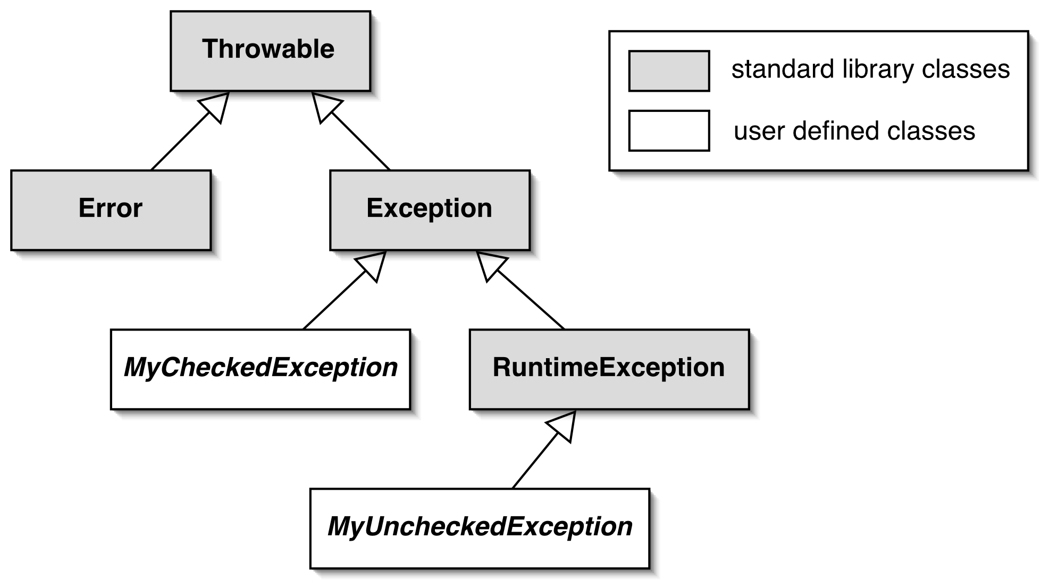
Overview of an exception class hierarchy
Notes:
Every class used as an exception should be inherited from class Throwable.
Error is a predecessor for exceptions indicating a fatal system error – OutOfMemoryError
Actually, Exception is used for plenty of exceptions.
Our exceptions often inherit from Exception or RuntimeException or their successors.

Slide 90
Main exception categories
Checked exceptions
  Subclass of Exception
  Used for anticipated failures.
  Where recovery may be possible.
  Should be handled in a method when raises or the method should be marked
Unchecked exceptions
  Subclass of RuntimeException
  Used for unanticipated failures.
  can raise uncontrolledly from a method

Slide 91
What exceptions does Java throw to us
Error – InternalError, OutOfMemoryError, VirtualMachineError, StackOverflowError.
Exception
  unchecked- RuntimeException and its successor
    ArithmeticException, IllegalArgumentException, UnsuportedOperationException, IllegalStateException,…
  checked – other successor of Exception
    ClassNotFoundException, DataFormatException, InterruptedException, IOException.
Notes:
InternalError is thrown when an unexpected internal error has occurred in the Java Virtual Machine.
OutOfMemoryError
VirtualMachineError indicates that the Java Virtual Machine is broken.
StackOverflowError – indicates that there is not enough memory to allocate more on stack – usually bad recursion.

Slide 92
The effect of an exception
The throwing method finishes exceptionally.
The throwing method returns no value.
Control does not return after the point of method call.
A client must/may handle an exception.

Slide 93
Unchecked exceptions
Compiler doesn’t check these exceptions
It causes program termination if not handled.
NotSupportedException is a typical example.

Slide 94
Example of an unchecked exception
public void setDimension(int width, int height)
{
if( (width < 0) || (height < 0) ) {
throw new IllegalArgumentException(
“Dimension should be greater or equal to 0: width=“
+width + ", height = "+height);
}
erase();
this.width = width;
this.height = height;
paint();
}
Notes:
The presented example shows using of IllegalArgumentException. It can be thrown whenever arguments of method is outside of the desired interval.

Slide 95
Preventing creation of object with invalid state
public Rectangle( int x, int y, int width, int height, MyColor color )
{
if( (x<0) || (y<0) || (width<=0) || (height<=0) ) {
throw new IllegalArgumentException(
"\nParameters doesn’t have permited values: x="
+ x + ", y=" + y + ", width=" + width + ", height=" + height );
}
this.xPos = x;
this.yPos = y;
this.width = width;
this.height = height;
this.color = color;
paint();
}
Notes:
IllegalArgumentException throwing can even prevent object creation. If an object is created with arguments that define illegal initial state, then an exception is thrown.

Slide 96
Exception handling
Checked exceptions are perceived to be caught and eventually handled.
The compiler ensures that their use is strictly controlled.
Used carefully, failures may be recoverable.
Notes:
Every checked exception should be caught in the method where it is raised or the method should be marked that it potentially should propagate the type of exception.

Slide 97
Example of block with an exception
try {
//critical section
} catch (IllegalArgumentException e) {
//handle exception o type IllegalArgumentException
} catch (NullPointerException | IOException e) {
//handle exception o type NullPointerException and IOException
} catch (Throwable e) {
//handle every exception – object o type Throwable
} finally {
//this block is always performed when the critical section is leaved
}
Notes:
This demonstrates full syntax of exception handling. It looks a little bit strange but we will explain it in more detail later

Slide 98
Throws clause
Methods that can propagate a checked exception must be marked with throws clause:
Every checked exception should be handled in the method or the method specifies exception throwing.
/**
*
* @param fileName
* @return
* @throws IOException
*/
public String filterInputFile(String fileName) throws IOException {
InputStream is = new FileInputStream(fileName);
StringBuilder sb = new StringBuilder();
int chars;
byte[] buffer = new byte[1024];
while (-1 != (chars = is.read(buffer))){
sb.append(new String(buffer,0 , chars));
}
is.close();
return sb.toString();
}

Slide 99
Try statement
The source code catching an exception must surround the call with the try statement:
try {
//this section contains commands that are source of exception throwing
} catch(Exception e) {
//caught exception is handled here,
//it is accessible as variable with name e
}

Slide 100
Try statement
1. Exception thrown from this method
try {
exceptionalFilter.filterInputFile(fileName);
//some following code
} catch(IOException e) {
System.out.println("Unable to process file " + fileName +
"exception thrown: " + e.getMessage());
}
2. Control moves here

Slide 101
Catching multiple exceptions
try {
//block of code that should throw exceptions
FileInputStream fis = new FileInputStream("input.txt");
//file processing
}
catch(EOFException e) {
// Take action on an end-of-file exception.
}
catch(FileNotFoundException e) {
// Take action on a file-not-found exception.
}
Notes:
A “try section” could be connected with more than one catch sections. Exception handling is according to generalization –if there is a section with an exception type to which the thrown exception can be cast, then the exception is caught. Evaluation of “catch” section is sequentially – an exception type in the “catch” section that is a subclass of the exception type in another “catch” section has to be closer to the try section.

Slide 102
Handling different exceptions by same block of code
try {
//block of code that should throw exceptions
FileInputStream fis = new FileInputStream("input.txt");
//file processing
}
catch(EOFException | FileNotFoundException e) {
// Take action on an end-of-file and
// file-not-found exception.
}
Notes:
A “try section” could be connected with more than one catch sections. Exception handling is according to generalization –if there is a section with an exception type to which the thrown exception can be cast, then the exception is caught. Evaluation of “catch” section is sequentially – an exception type in the “catch” section that is a subclass of the exception type in another “catch” section has to be closer to the try section.

Slide 103
Finally clause
try {
// Protect one or more statements here.
}
catch(Exception e) {
// Report and recover from the exception here.
}
finally {
// Perform any actions here common to whether or not
// an exception is thrown.
}
Notes:
A section “finally” is executed whenever execution leaves an associated “try” section:
Because “try” section was fully executed
Exception in the “try” section was thrown and it was not caught
Exception in the “try” section was thrown, it was also caught and a corresponding “catch” section finished
“Return” statement was executed in the “try section”

Slide 104
Finally clause
The finally clause is executed even if a return statement is executed in the try or catch clauses.
An uncaught or propagated exception still exits via the finally clause.

Slide 105
Exception conversion
Used when we need propagate a different exception type from a method
Often used to the conversion into the RuntimeException or another unchecked exception
try {
…
…
…
…
} catch (CException e) {
throw new NCException(e);
}
Notes:
There is often a case that our code catches a kind of exception because it uses some API (e.g. it accesses the file system or communicates through the network) but it has to throw another kind of exception. It is solved that the handling code only wraps the caught exception with another one and re-throws it.
It is even often used to wrap a checked exception to an unchecked exception.

Slide 106
Features of exceptions
methods:
  getMessage
  toString
  printStackTrace
  printStackTrace(PrintStream)
Notes:
Class “Throwable” defines the methods that provides useful information from the object of the thrown exception:
getMessage – it contains a textual description of the exception
printStackTrace – it prints place history of the called methods before the exception was thrown.

Slide 107
Defining new exception types
Extend RuntimeException for an unchecked or Exception for a checked exception.
We use our exception type to improve diagnostic information.
  It can contain additional reporting and/or recovery information.
Notes:
Exception class is a common class that inherits form RuntimeException or Exception class. It improves our control of error handling in the defined code.

Slide 108
Defining new exception types in an action
public class NotConnectedException extends Exception {
private String host;
public NotConnectedException(String address) {
super("Host: " + address + " is not accesible");
host = address;
}
public String getHost() {
return host;
}
@Override
public String toString() {
return "NotConnectedException [host=" + host
+ ", getMessage()="
+ getMessage() + "]";
}
}
Notes:
The presented exception was thrown in real software whenever a failure in the connection to a server occures.

Slide 109
Error recovery
Clients should take description of error notifications.
  After method calling, it checks the method return values.
  Exceptions should not be ‘ignored’.
Client code usually attempts to recover.
  It is often implemented in a loop.

Slide 110
Attempting recovery
// Try to save the index file.
boolean successful = false;
int attempts = 0;
do {
try {
indexFile.saveToFile(filename);
successful = true;
}
catch(IOException e) {
System.out.println("Unable to save to " + filename);
attempts++;
if(attempts < MAX_ATTEMPTS) {
filename = getAlternativeFileName(filename);
}
}
} while(!successful && attempts < MAX_ATTEMPTS);
if(!successful) {
//Report the problem and give up;
}

Slide 111
Enhanced syntax of “try” - motivation
BufferedReader reader = null;
try {
reader = new BufferedReader(new FileReader("filename"));
}
catch(FileNotFoundException e) {
//the specified file could not be found
}
catch(IOException e) {
//something went wrong with reading
} finally {
try {
if (reader != null) reader.close();
} catch (IOException e) {
//something went wrong with closing
}
}

Slide 112
Enhanced syntax of “try”
try (BufferedReader reader
= new BufferedReader(new FileReader("filename"))){
String line = null;
while(null != (line = reader.readLine())) {
//do something with line
}
}
catch(FileNotFoundException e) {
//the specified file could not be found
}
catch(IOException e) {
//something went wrong with reading
}

Slide 113
Enhanced syntax of “try” - usage
It can be used on any class that implements interface Autocloseable
public interface Autocloseable {
public void close() throws Exception;
}

Slide 114
4th lecture – Java Collection Framework
General Architecture
Interfaces
Implementations
Notes:
progress

Slide 115
Collections in Java
Collection (container)- objects that groups multiple elements into single unit.
Collections Framework:
  Interfaces – abstract data types representing collections
  Implementations - concrete implementations of the interfaces – general, legacy, special-purpose, concurrent, wrapper, abstract
  Algorithms - methods that perform useful computations (searching and sorting)
Notes:
<number>

Slide 116
Collection types hierarchy
Extended from:
  java.util.Collection
  java.util.Map
java.util.Map – not true collection but offers collection-like manipulation

Slide 117
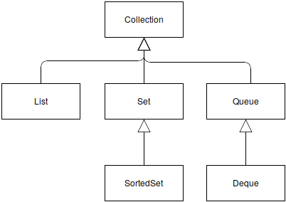
java.util.Collection - hierarchy

Slide 118
java.util.Collection
base interface
used to define a group of objects – allow manipulation, uniqueness and ordering is not defined for the interface
methods:
  add(E), addAll(Collection<E>), remove(E), removeAll(Collection<E>), clear(), retainAll(Collection<E>) – add/remove elements
  size():int, isEmpty():boolean – check number of elements
  contains (Object):boolean – check existence of element
  iterator() - returns new iterator – enable browsing
  toArray()

Slide 119
java.util.List
ordered(defined index for every element) collection that may contain duplicate elements
methods:
  <extends Collection>
  add(int,E), set(int,E), addAll(int,Collection<E>), get(int):E, remove(int):E – add/remove elements to/from given position
  indexOf(Object):int, lastIndexOf(Object):int – find position of given object
  listIterator():ListIterator – return iterator that allows forward/backward browsing

Slide 120
java.util.Set
collection of elements that does not contain duplicates
methods:
  <extends Collection>
  add(E):boolean, addAll(Collection<E>), contains(Object):boolean – added constraints to inherited methods

Slide 121
java.util.SortedSet
set of elements where is defined ordering (index for items are not defined)
methods:
  <extends Set>
  comparator(): Comparator<E>
  subSet(E, E): SortedSet<E>
  headSet(E): SortedSet<E>
  tailSet(E): SortedSet<E>
  first(): E
  last(): E

Slide 122
java.util.Queue
Queue is a list of elements with a first in first out ordering.
When you enqueue an element, it adds it to the end of the list.
When you dequeue an element, it returns the element at the front of the list and removes that element from the list.
methods:
  <extends Collection>
  add(E), offer(E) – enqueue
  remove(): E, poll(): E – dequeue
  element():E, peek():E – retrieves but not remove

Slide 123
java.util.Deque
double ended queue,
enables enqueue to the start and dequeue from the end,
provides stack functionality
methods:
  <extends Queue>
  addLast/addFirst; getLast/getFirst – manipulation with end or beginning
  push(E), pop(): E
  descendingIterator(): Iterator<E>

Slide 124
Choose type of collection
choose more general type.
Iterable – only browsing (.. .and remove by iterator).
others – modification (add, remove), provide size information, check existence of elements.
 | Ordered | Indexed | Unique | FIFO | LIFO
Collection
List | Y | Y
Queue | Y |  |  | Y
Deque | Y |  |  | Y | Y
Set |  |  | Y
OrderdSet | Y |  | Y
Map |  | Y – by key | Y – only key

Slide 125
java.util.Map
is a collection that links a key to a value.
cannot contains duplicates of key – each key can only exists once and can only link to a single value.
for key and value could be used any type

Slide 126

java.util.map - example
map String → MyColor
insert pairs
get value for a specific key

Slide 127
java.util.Map – another methods
containsKey(Object): boolean
containsValue(Object): boolean
keySet(): Set<K>
values(): Collection<V>
entrySet: Set<Entry<K,V>>
remove(Object): V
size(): int

Slide 128
Collection Implementations
Interface | Hash Table | Resizable Array | Balanced Tree | Linked List | Hash Table + Linked List
Set | HashSet |  | TreeSet |  | LinkedHashSet
Collection | HashSet | ArrayList | TreeSet | LinkedList | LinkedHashSet
List |  | ArrayList |  | LinkedList
Queue |  | ArrayDeque |  | LinkedList
Deque |  | ArrayDeque |  | LinkedList
Map | HashMap |  | TreeMap |  | LinkedHashMap

Slide 129
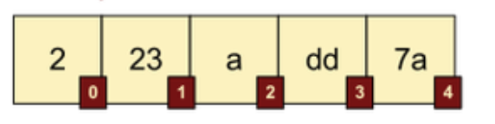
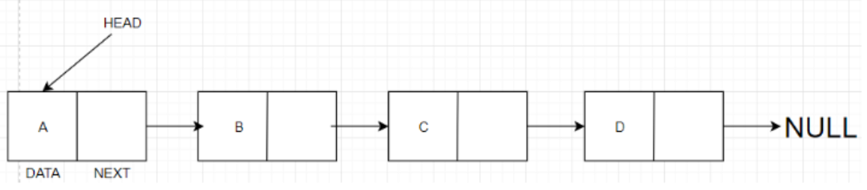
List implementation: ArrayList vs LinkedList
Definition:
  ArrayList: A resizable array implementation of the List interface.
  LinkedList: A doubly-linked list implementation of the List and Deque interfaces.
Performance:
  ArrayList has a faster average time for accessing elements as it uses an index-based system.
  LinkedList has a faster average time for adding and removing elements.
Memory Usage:
  ArrayList uses less memory as it holds only data.
  LinkedList uses more memory as it holds data and two references for neighbor nodes.
Use Case:
  Use ArrayList when you have a fixed-size list, and you know the size won't change.
  Use LinkedList when you have to change the list size frequently by adding or removing elements.
Syntax:
  List<String> arrayList = new ArrayList<>();
  List<String> linkedList = new LinkedList<>();

Slide 130
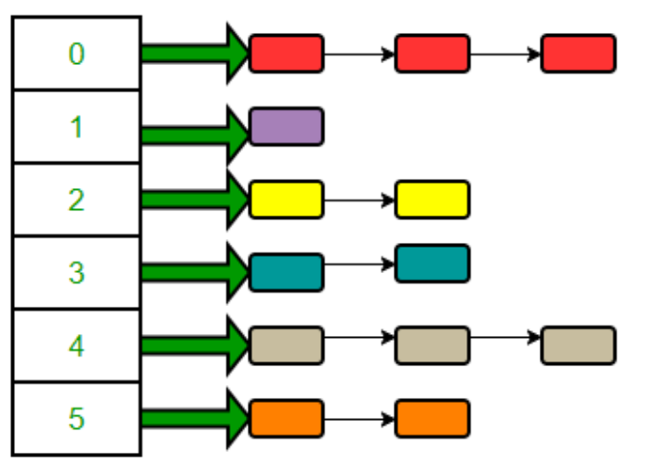
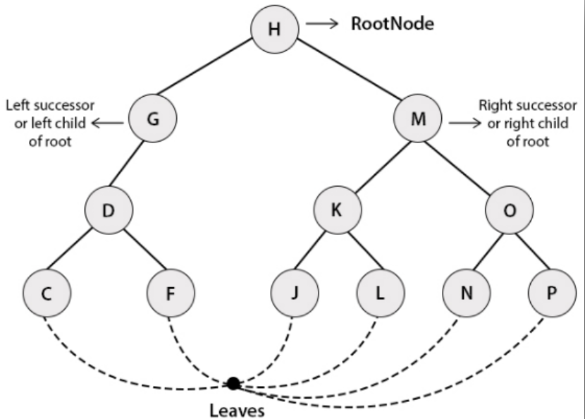
Map implementation: HashMap vs TreeMap
Definition:
  HashMap: Part of Java's collection since Java 1.2, provides the basic implementation of Map interface by hash table
  TreeMap: A Red-Black tree based NavigableMap implementation, sorted according to the natural ordering of its keys.
Performance:
  HashMap generally offers constant time performance for the basic operations — get and put.
  TreeMap guarantees log(n) time cost for the containsKey, get, put, and remove operations.
Ordering:
  HashMap does not maintain any order of its keys.
  TreeMap maintains ascending order of its keys.
Null Keys and Values:
  HashMap allows one null key and multiple null values.
  TreeMap does not allow null keys but may contain multiple null values.
Use Case:
  Use HashMap when you do not need sorted keys, and you need better performance.
  Use TreeMap when you need sorted keys, and you can compromise on performance for ordering.
Syntax:
  Map<String, String> hashMap = new HashMap<>();
  Map<String, String> treeMap = new TreeMap<>();

Slide 131
Set implementation: HashSet, TreeSet
It is implemented by HashMap / TreeMap

Slide 132
Requirements of using hash tables
classes of objects (value objects) stored in hash tables:
  objects stored in HashSet
  keys used with HashMap
should correctly override:
  hashCode
  equals (important also for comparison).
value object – instances where their identity is not important but their state – String, Date, Money, Fraction, ComplexNumber…

Slide 133
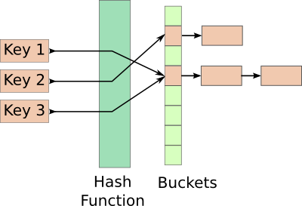
hashCode method
provide hash function for given object
for two objects representing the same value must return same result
for two objects representing different values should return different results – collisions are sometimes necessary

Slide 134
equals method
used for distinguishing between object targeting the same bucket
for two objects representing the same value must return true
for two objects representing different values must return false
used also in implementation of method contains (declared in Collection)

Slide 135
5th lecture
Algorithms implemented for Collections
Comparable/Comparator interface
Iterable/Iterator interface
Immutable objects

Slide 136
Algorithm
Class “java.util.Collections ”
  Sorting
  Shuffling
  Routine data manipulation
  Searching
  Composition
  Finding extreme values
Notes:
<number>

Slide 137
Algorithm – shuffling, data manipulation
shuffling
  void shuffle(List<?> list)
  void shuffle(List<?> list, Random rnd)
data manipulation
  void swap(List<?>, int i, int ii)
  <T> void fill(List<? super T> list, T obj)
  <T> void copy(List<? super T> dest, List<? extends T> src)
  void reverse(List<?> list)
  <T> boolean addAll(Collection<? super T> c, T... elements)

Slide 138
Algorithm – Searching, Composition, Finding Extreme values
Searching
  int binarySearch(List<? extends Comparable<? super T>> list, T key)
  int binarySearch(List<? extends T> list, T key, Comparator<? super T> c)
Composition
  int frequency(Collection<?> c, Object o)
  boolean disjoint(Collection<?> c1, Collection<?> c2)
Finding Extreme Values
  <T extends Comparable> T max(Collection<? extends T> coll)
  <T> T max(Collection<? extends T> coll, Comparator<? super T> comp)
  <T extends Comparable> T min(Collection<? extends T> coll)
  <T> T min(Collection<? extends T> coll, Comparator<? super T> comp)

Slide 139
Some useful interfaces - comparing
We often need to compare objects of the same type (class or interface) with each other. According to ordering.
Comparable/ Comparator

Slide 140

Comparable
Comparable object can itself compare with another object of the same type.
-1 if this < t
1 if this > t
0 if this = t
public class ComparingIntegers {
public static void main(String[] args) {
Integer int_10 = 10;
Integer int_100 = 100;
Integer int_1000 = 1000;
System.out.println("CompareTo result : " + int_10.compareTo(int_100));
// displays -1 because 10 < 100
System.out.println("CompareTo result : " + int_1000.compareTo(int_100));
// displays 1 because 1000 > 100
System.out.println("CompareTo result : " + int_100.compareTo(int_100));
// displays 0 because 100 == 100
}
}

Slide 141

Comparator
if we want to have several ways of comparing, we cannot implement the Comparable interface several times !
Define a comparator once, and use it everywhere!
Comparator object can compare two objects of the same type
-1 if o1 < o2
1 if o1 > o2
0 if o1 = o2

Slide 142

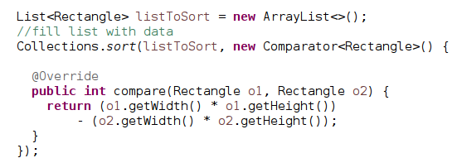
Algorithm – sorting – Comparable/Comparator using
list of comparable objects
list of non-comparable objects

Slide 143

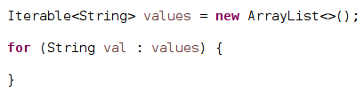
Some useful interface - Iterable
base type for Collection (Collection extends Iterable)
provides a comfort way for a loop construction – for-each

Slide 144
Some useful interface - Iterator
public interface Iterator<E> {
/**
* Returns {@code true} if the iteration has more elements.
* (In other words, returns {@code true} if {@link #next} would
* return an element rather than throwing an exception.)
*
* @return {@code true} if the iteration has more elements
*/
boolean hasNext();
/**
* Returns the next element in the iteration.
*
* @return the next element in the iteration
* @throws NoSuchElementException if the iteration has no more elements
*/
E next();
void remove();
}

Slide 145
Loop through collection by iterator
Collection<String> strings = Arrays.asList("a", "b", "c");
Iterator<String> iter = strings.iterator();
while(iter.hasNext()) {
String val = iter.next();
//can remove by iter.remove()
}

Slide 146
Immutable objects
An immutable object is an object whose state cannot be changed after its initialization.
A good example in the Java Core API is the java.lang.String class.
Some objects can remain immutable throughout their lifetime.
Why?
One way to avoid concurrency problems is to share only immutable objects between multiple threads.

Slide 147
Immutable objects
The keyword « final »
In Java, variables are mutable by default, which means we can modify the value they contain.
By using the final keyword when declaring a variable, the Java compiler will deny any change on this variable -> Compilation error
Technique used for the declaration of constants
public final static double PI = 3.14159

Slide 148
Immutable objects
Implementing immutability - To make an immutable object :
Its class must be final to prevent the creation of a child class that would modify its state by adding or redefining methods
All attributes must be private to prevent access to data without going through a method of the class and final to avoid any modification after initialization
Its class must not give a setter or methods that could modify the state of the object
It should give only getters and methods that return immutable objects or copies (other instances)
Do not implement the Cloneable interface

Slide 149
Immutable Objects
Characteristics:
Immutable objects :
Are easy to create, test and use
Their hash value remains unchanged and can even be cached once calculated in the constructor: they are therefore to be preferred in Map and Set collections
Examples: All the wrapper type classes of the java.lang package are immutable: Boolean, Byte, Character, Double, Float, Integer, Long and Short.

Slide 150
Immutable Objects
Example
public class TestString {
public static void main(String[] args)
{
String chain = new String(" Good morning ! ");
System.out.println(chain);
String str = chain.replaceAll(" morning ", " evening");
System.out.println(chain);
System.out.println(str);
}
}

Slide 151
Immutable Objects
import java.util.Date;
public final class Person {
private final String name;
private final Date birthDate;
public Person(String name, Date birthDate) {
this.name = name;
this.birthDate = birthDate;
}
public String getName() { return name; }
public Date getBirthDate() { return birthDate; }
@Override
public String toString() {
StringBuilder result = new StringBuilder("name=");
result.append(name);
result.append(", birthDate=");
result.append(birthDate);
return result.toString();
}
}
import java.util.Date;
public class TestImmuable {
public static void main(String[] args) {
Date birthDate = new Date();
Person person = new Person("name1", birthDate); System.out.println(person);
Date newBirthDate = person.getBirthDate();
newBirthDate.setMonth(newBirthDate.getMonth() + 1);
System.out.println(person);
}
}
Execution:
name=name1, birthdate = Sat Dec 03 20:58:49 CET2019
name=name1, birthdate = Tue Jan 03 20:58:49 CET2020
the class Date is mutable => the class Person is mutable because you can modify its attributes (in this example birthDate). It is therefore necessary that the getters return an immutable instance or another instance of the attribute

Slide 152
Immutable Objects
import java.util.Date;
public final class Person {
private final String name;
private final Date birthDate;
public Person(String name, Date birthDate) {
this.name = name;
this.birthDate = birthDate;
}
public String getName() { return name; }
public Date getBirthDate() { return new Date (birthdate.getTime()); }
@Override
public String toString() {
StringBuilder result = new StringBuilder("name=");
result.append(name);
result.append(", birthDate=");
result.append(birthDate);
return result.toString();
}
}
import java.util.Date;
public class TestImmuable {
public static void main(String[] args) {
Date birthDate = new Date();
Person person = new Person("name1", birthDate); System.out.println(person);
Date newBirthDate = person.getBirthDate();
newBirthDate.setMonth(newBirthDate.getMonth() + 1);
System.out.println(person);
}
}
Execution:
name=name1, birthdate = Sat Dec 03 20:58:49 CET2019
name=name1, birthdate = Sat Dec 03 20:58:49 CET2019
The result is the same, but the Person class is not yet immutable.

Slide 153
Immutable Objects
import java.util.Date;
public final class Person {
private final String name;
private final Date birthDate;
public Person(String name, Date birthDate) {
this.name = name;
this.birthDate = birthDate;
}
public String getName() { return name; }
public Date getBirthDate() { return new Date (birthdate.getTime()); }
@Override
public String toString() {
StringBuilder result = new StringBuilder("name=");
result.append(name);
result.append(", birthDate=");
result.append(birthDate);
return result.toString();
}
}
import java.util.Date;
public class TestImmuable {
public static void main(String[] args) {
Date birthDate = new Date();
Person person = new Person("name1", birthDate); System.out.println(person);
Date newBirthDate = person.getBirthDate();
birthDate.setMonth(newBirthDate.getMonth() + 1);
System.out.println(person);
}
}
Execution:
name=name1, birthdate = Sat Dec 03 20:58:49 CET2019
name=name1, birthdate = Tue Jan 03 20:58:49 CET2020
the class Date is mutable => the class Person is mutable because you can modify its attributes (in this example birthDate). It is therefore necessary that the getters return an immutable instance or another instance of the attribute

Slide 154
Immutable Objects
import java.util.Date;
public final class Person {
private final String name;
private final Date birthDate;
public Person(String name, Date birthDate) {
this.name = name;
this.birthDate = new Date (birthdate.getTime());
}
public String getName() { return name; }
public Date getBirthDate() { return new Date (birthdate.getTime()); }
@Override
public String toString() {
StringBuilder result = new StringBuilder("name=");
result.append(name);
result.append(", birthDate=");
result.append(birthDate);
return result.toString();
}
}
import java.util.Date;
public class TestImmuable {
public static void main(String[] args) {
Date birthDate = new Date();
Person person = new Person("name1", birthDate); System.out.println(person);
Date newBirthDate = person.getBirthDate();
birthDate.setMonth(newBirthDate.getMonth() + 1);
System.out.println(person);
}
}
Execution:
name=name1, birthdate = Sat Dec 03 20:58:49 CET2019
name=name1, birthdate = Sat Dec 03 20:58:49 CET2019
the class Date is mutable => the class Person is mutable because you can modify its attributes (in this example birthDate). It is therefore necessary that the getters return an immutable instance or another instance of the attribute

Slide 155
Immutable Objects – Defensive Copy
The purpose of defensive copy is to work on a copy of an object rather than the original object to prevent the state of that object from being changed outside of its class on purpose or not. Defensive copying is also used, as we saw in Example 2, in achieving immutability.
A class can have an attribute which is a mutable object. There are then two design choices to modify the state of this object: o
  Either this state is only modified by the class which encapsulates the object because it protects its access
  Either the object can be returned to a caller who can then change its state
•When an instance of this object is passed as a parameter or in return from a method of another class, the latter has no way:
  to know the other objects which have a reference on the instance
  and if the object is mutable, to know what modifications will be made on it from these references
Thus, to preserve the encapsulation rules, the defensive copy must be implemented when:
  a mutable object is passed as a parameter of a setter or a constructor
  a mutable object is returned by a getter
Without this, it becomes possible for the wrapped object to be modified outside of its class.

Slide 156
Immutable Objects – Defensive Copy
import java.util.ArrayList; import java.util.List;
public class MyList {
List<String> list = new ArrayList<String>();
public void add(String s) {
list.add(s);
}
public List<String> getList() {
return Collections.unmodifiableList(list);
}
}
NB: To maintain control over the state of the collection, it is possible to return a copy of the instance. Here we are returning a non-editable copy, which can be used to get an item or browse all or part of the items but without being able to add, modify or delete an item.

Slide 157
6th lecture
Generics
Wrapper Classes
Lambda expression
Built-in interfaces
Java SE8 Streams

Slide 158
Generics
Known as parameterized types or templates.
Introduce parameters into class definition.
Benefits of generic types
  increased expressive power,
  improved type safety,
  explicit type parameters and implicit type casts.

Slide 159
Collections with generics
The main point: “old” containers hold “Object” objects and need casts which are problematic because cast is something the programmer thinks is true at a single point.
Generic type is true everywhere
List li = new ArrayList();
li.add(new Integer(1));
Integer x = (Integer) li.get(0);
List<Integer> li = new ArrayList<>();
li.add(new Integer(1));
Integer x = li.get(0);

Slide 160
Definition of generics
type variable = "placeholder" for an unknown type
interface Collection<A> {
public void add (A x);
public Iterator<A> iterator();
}
class LinkedList<A> implements Collection<A> {
protected class Node {
A elt;
Node next = null;
Node (A elt) { this.elt = elt;}
}
…
}

Slide 161
Generics – type parameter bounds
bounds = super-type of a type variable
  purpose: make available non-static methods of a type variable
  limitations: gives no access to constructors or static methods
public interface Comparable<T> {
public int compareTo(T arg);
}
public class TreeMap<K extends Comparable,V> {
private static class Entry<K,V> { ... }
private Entry<K,V> getEntry(K key) {
while(p != null) {
int cmp= k.compareTo(p.key);
… }
…
}…
}

Slide 162
Generics – using generic types as variables
with specific type arguments
  specific instantiation
without type arguments
  raw type - no type argument specified, permitted for compatibility reasons, permits mix of non-generic (legacy) code with a generic code
with wildcard arguments
  wildcard instantiation

Slide 163
Generics –wildcards
void printCollection( Collection<Object> c){
for (Object o : c) {
System.out.println(o);
}// Collection<Object> is NOT supertype of any
} //other collection – this code is useless
/**
* The solution is wildcards.
*/
void printCollection( Collection<?> c){
for (Object o : c) {
System.out.println(o);
}
}

Slide 164
Generics – bounded wildcards
unbounded wildcard -?
  all types
lower-bound wildcard - ? extends Supertype
  all types that are subtypes of Supertype
  used for “Input” – where is value of a parameter type gained from an object of generic type accessed as Supertype
upper-bound wildcard - ? super Subtype
  all types that are supertypes of Subtype
  used for “Output” – where is value of a parameter type stored into an object of generic type as Subtype

Slide 165
Generics methods
Average() method signature:
static double average(List<? extends Number> nums)
Alternative (equivalent) signature:
static <T extends Number>double average(List<T> nums)
The latter is called a generic method.
Which is better?
  When there are no dependencies between the method parameters - use wildcards.

Slide 166
Wrapper classes
Generic types are limited for working with object types.
For every primitive type exists corresponding object type.
Java compiler converts between primitive type and its object equivalent – if it is necessary.

Slide 167
Wrapper class
Double objectDoubleValue = 3.14e12;
double doubleValue = objectDoubleValue;
int intValue = objectDoubleValue.intValue();
boolean boolValue = Boolean.parseBoolean("true");
Integer intObjectValue = Integer.valueOf(150);
Integer intObjectValueFromString = Integer.valueOf("150");
Notes:
For every primitive type, there exists a class in package java.lang: Boolean, Char, Byte, Short, Integer, long, Float, Double
Compiler can automatically convert values between both representations.
Instance of wrapper class can be created explicitly by the constructor or class method valueOf().
Method xxxValue return value of object.
The classes contain method parseXXX(String) that return the primitive value from String.

Slide 168
List of wrapper classes
valueOf method – conversion from a primitive type or string to object wrapper
parseXXX method (e.g. parseFloat()) parse String and returns specific value as primitive type
xxxValue method (e.g. floatValue()) returns the value in a specific primitive type.

Slide 169
java.lang.Character wrapper class
Character.isDefined(char c)
Character.isDigit(char c)
Character.isLetter(char c)
Character.isLowerCase(char c)
Character.isUpperCase(char c)
Character.isWhitespace(char c)
Character.toLowerCase(char c)
Character.toUpperCase(char c)
Notes:
This class contains many useful methods.

Slide 170
Lambda expression
interface CheckPerson {
boolean test(Person p);
}
public static void printPersons(
List<Person> roster, CheckPerson tester) {
for (Person p : roster) {
if (tester.test(p)) {
p.printPerson();
}
}
}
printPersons(
roster,
new CheckPerson() {
public boolean test(Person p) {
return p.getGender() == Person.Sex.MALE
&& p.getAge() >= 18
&& p.getAge() <= 25;
}
}
);
printPersons(
roster,
(Person p) -> p.getGender() == Person.Sex.MALE
&& p.getAge() >= 18
&& p.getAge() <= 25
);

Slide 171
Lambda expression description
Substitutes syntax for a creation of anonymous classes where an object of functional interface (interface having only one abstract method defined) type is expected.
It is recommended to annotate a functional interfaces with the annotation @FunctionalInterface. Compiler check whether it is declared correctly.

Slide 172
Syntax of lambda expressions
A comma-separated list of formal parameters enclosed in parentheses. (You can omit the data type of the parameters in a lambda expression. In addition, you can omit the parentheses if there is only one parameter. )
The arrow token, ->
p -> p.getGender() == Person.Sex.MALE && p.getAge() >= 18
&& p.getAge() <= 25

Slide 173
Syntax of lambda expressions II.
A body, which consists of a single expression or a statement block.
You do not have to enclose a void method invocation in braces.
p -> p.getGender() == Person.Sex.MALE && p.getAge() >= 18
&& p.getAge() <= 25
p -> {
return p.getGender() == Person.Sex.MALE && p.getAge() >= 18
&& p.getAge() <= 25;
}
email -> System.out.println(email)

Slide 174
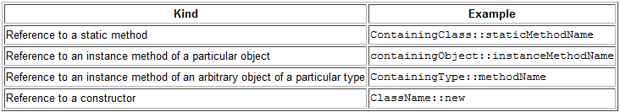
Method References
a lambda expression does nothing but call an existing method - refer to the existing method by name
Arrays.sort(rosterAsArray, (a, b) -> Person.compareByAge(a, b) );
Arrays.sort(rosterAsArray, Person::compareByAge);

Slide 175
Standard functional interfaces
Interface | Function Signature | Example
UnaryOperator<T> | T apply(T t) | String::toLowerCase
BinaryOperator<T> | T apply(T t1, T t2) | BigInteger::add
Predicate<T> | boolean test(T t) | Collection::isEmpty
Function<T,R> | R apply(T t) | Arrays::asList
Supplier<T> | T get() | Instant::now
Consumer<T> | void accept(T t) | System.out::println

Slide 176
Functional interface
If one of the standard functional interfaces does the job, you should generally use it in preference to a purpose-built functional interface.
Don’t be tempted to use basic functional interfaces with boxed primitives instead of primitive functional interfaces.
Always annotate your functional interfaces with the @FunctionalInterface annotation.

Slide 177

Java SE8 Streams
List<Transaction> groceryTransactions = new ArrayList<>();
for(Transaction t: groceryTransactions){
if(t.getType() == Transaction.GROCERY){
groceryTransactions.add(t);
}
}
Collections.sort(groceryTransactions, new Comparator<>(){
public int compare(Transaction t1, Transaction t2){
return t2.getValue().compareTo(t1.getValue());
}
});
List<Integer> transactionsIds = new ArrayList<>();
for(Transaction t: groceryTransactions){
transactionsIds.add(t.getId());
}
List<Integer> transactionsIds =
groceryTransactions.stream()
.filter(t -> t.getType() == Transaction.GROCERY)
.sorted(comparing(Transaction::getValue).reversed())
.map(Transaction::getId)
.collect(toList());

Slide 178
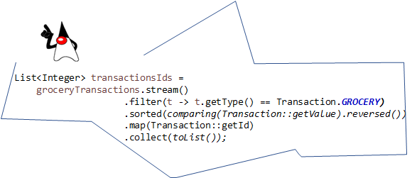
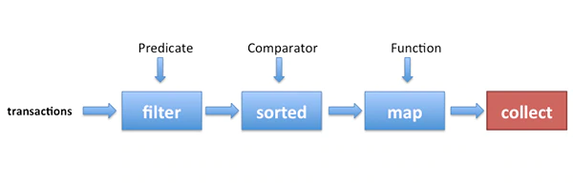
Streams overview

Slide 179
Getting Started with Streams
Sequence of elements – to a sequenced set of values of a specific element type but computed on demand;
Source - collections, arrays, or I/O resources;
Aggregate operations – functional operations – filter, map, reduce, find, match, sorted

Slide 180
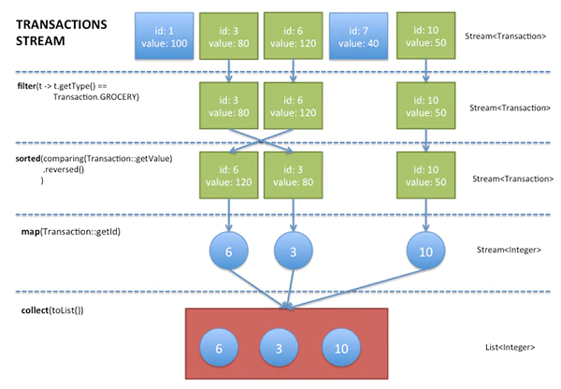
Stream operations - characteristics
Pipelining - Many stream operations return a stream themselves, it enables - laziness and short-circuiting
Internal iteration

Slide 181
Streams Versus Collections
About a computation vs about data
Not replacement – collections allows multiple processing and modification
For arguments, return values and instance variables collections are preferred

Slide 182
Stream operations
Intermediate operations - together form pipeline – filter, sorted, map
Intermediate operations - reduce pipeline (close) – collect, reduce, min, max, anyMatch, first…

Slide 183
Filtering
filter(Predicate) distinct: Returns a stream with unique elements (according to the implementation of equals for a stream element)
distinct
limit(n)
skip(n)
Optional<Transaction> result=
transactions.stream()
.filter(t -> t.getType() == Transaction.GROCERY)
.findAny();

Slide 184
Optional<T>
It is a container class to represent the existence or absence of a value.
Several methods
transactions.stream()
.filter(t -> t.getType() == Transaction.GROCERY)
.findAny()
.ifPresent(System.out::println);

Slide 185

Mapping and reducing
List<String> words = Arrays.asList("Oracle", "Java", "Magazine");
List<Integer> wordLengths =
words.stream()
.map(String::length)
.collect(toList());

Slide 186
Numeric streams
IntStream - mapToInt
DoubleStream - mapToDouble
LongStreams – mapToLong
Additional methods: sum, average, summaryStatistics
int statementSum =
transactions.stream()
.mapToInt(Transaction::getValue)
.sum(); // works!

Slide 187
range, rangeClosed
Another way for creation of numeric streams
Range – exclusive, rangeClosed - inclusive
IntStream oddNumbers =
IntStream.rangeClosed(10, 30)
.filter(n -> n % 2 == 1);

Slide 188
Building streams
From collections – stream()
Stream.of - Stream<Integer> numbersFromValues = Stream.of(1, 2, 3, 4);
Arrays.stream() - IntStream numbersFromArray = Arrays.stream(new int [] {10,23,45});
Stream.iterate(), Stream.generate() – infinite streams
Stream<Integer> numbers = Stream.iterate(0, n -> n + 10);
Convert to a finite stream
numbers.limit(5).forEach(System.out::println); // 0, 10, 20, 30, 40

Slide 189
7th lecture
Reflection API

Slide 190
Java Reflection: Reference
http://tutorials.jenkov.com/java-reflection/index.html

Slide 191
Java Reflection
Method[] methods = MyObject.class.getMethods();
for(Method method : methods){
System.out.println("method = " + method.getName());
}

Slide 192
Java Reflection: Class object
Class myObjectClass = MyObject.class
myObjectClass = obj.getClass();
myObjectClass = Class.forName(“some.MyClass”);

Slide 193
Java Reflection: Class Name
String className = aClass.getName();
String simpleClassName = aClass.getSimpleName();

Slide 194
Java Reflection: Class modifiers
Class aClass = ... //obtain Class object. See prev. section
int modifiers = aClass.getModifiers();
Modifier.isAbstract(int modifiers)
Modifier.isFinal(int modifiers)
Modifier.isInterface(int modifiers)
Modifier.isNative(int modifiers)
Modifier.isPrivate(int modifiers)
Modifier.isProtected(int modifiers)
Modifier.isPublic(int modifiers)
Modifier.isStatic(int modifiers)
Modifier.isStrict(int modifiers)
Modifier.isSynchronized(int modifiers)
Modifier.isTransient(int modifiers)
Modifier.isVolatile(int modifiers)

Slide 195
Java Reflection: Other class features
Class aClass = ... //obtain Class object. See prev. section
Package package = aClass.getPackage();
Class superclass = aClass.getSuperclass();
Class aClass = ... //obtain Class object. See prev. section
Class[] interfaces = aClass.getInterfaces();

Slide 196
Java Reflection: Constructors
Constructor[] constructors = aClass.getConstructors();
…
Class aClass = ...//obtain class object
Constructor constructor =
aClass.getConstructor(new Class[]{String.class});
…
Constructor constructor = ... // obtain constructor - see above
Class[] parameterTypes = constructor.getParameterTypes();
…
//get constructor that takes a String as argument
Constructor constructor = MyObject.class.getConstructor(String.class);
MyObject myObject = (MyObject)
constructor.newInstance("constructor-arg1");

Slide 197
Java Reflection: Methods
Class aClass = ...//obtain class object
Method[] methods = aClass.getMethods();
…
Class aClass = ...//obtain class object
Method method =
aClass.getMethod("doSomething", new Class[]{String.class});
…
Class aClass = ...//obtain class object
Method method =
aClass.getMethod("doSomething", null);
…
Method method = ... // obtain method - see above
Class[] parameterTypes = method.getParameterTypes();
Class returnType = method.getReturnType();
…
//get method that takes a String as argument
Method method = MyObject.class.getMethod("doSomething", String.class);
Object returnValue = method.invoke(null, "parameter-value1");

Slide 198
Java Reflection: Access private methods
public class PrivateObject {
private String privateString = null;
public PrivateObject(String privateString) {
this.privateString = privateString;
}
}
PrivateObject privateObject = new PrivateObject("The Private Value");
Field privateStringField = PrivateObject.class.
getDeclaredField("privateString");
privateStringField.setAccessible(true);
String fieldValue = (String) privateStringField.get(privateObject);
System.out.println("fieldValue = " + fieldValue);

Slide 199
Java Reflection: Getters and Setters

Slide 200
Java Reflection: Fields
public class MyObject{
public String someField = null;
}
Class aClass = MyObject.class;
Field[] fields = aClass.getFields();
Field field = aClass.getField("someField");
…
String fieldName = field.getName();
Object fieldType = field.getType();
…
MyObject objectInstance = new MyObject();
Object value = field.get(objectInstance);
field.set(objetInstance, value);

Slide 201
Java Reflection: Annotations
@MyAnnotation(name="someName", value = "Hello World")
public class TheClass {
}
@Retention(RetentionPolicy.RUNTIME)
@Target(ElementType.TYPE)
public @interface MyAnnotation {
public String name();
public String value();
}

Slide 202
Java Reflection: Class Annotations
Class aClass = TheClass.class;
Annotation[] annotations = aClass.getAnnotations();
for(Annotation annotation : annotations){
if(annotation instanceof MyAnnotation){
MyAnnotation myAnnotation = (MyAnnotation) annotation;
System.out.println("name: " + myAnnotation.name());
System.out.println("value: " + myAnnotation.value());
}
}
Class aClass = TheClass.class;
Annotation annotation = aClass.getAnnotation(MyAnnotation.class);
if(annotation instanceof MyAnnotation){
MyAnnotation myAnnotation = (MyAnnotation) annotation;
System.out.println("name: " + myAnnotation.name());
System.out.println("value: " + myAnnotation.value());
}

Slide 203
Java Reflection: Methods Annotations
public class TheClass {
@MyAnnotation(name="someName", value = "Hello World")
public void doSomething(){}
}
Method method = ... //obtain method object
Annotation[] annotations = method.getDeclaredAnnotations();
for(Annotation annotation : annotations){
if(annotation instanceof MyAnnotation){
MyAnnotation myAnnotation = (MyAnnotation) annotation;
System.out.println("name: " + myAnnotation.name());
System.out.println("value: " + myAnnotation.value());
}
}
Method method = ... // obtain method object
Annotation annotation = method.getAnnotation(MyAnnotation.class);
if(annotation instanceof MyAnnotation){
MyAnnotation myAnnotation = (MyAnnotation) annotation;
System.out.println("name: " + myAnnotation.name());
System.out.println("value: " + myAnnotation.value());
}

Slide 204
Java Reflection: Parameter Annotations
public class TheClass {
public static void doSomethingElse(
@MyAnnotation(name="aName", value="aValue") String parameter){
}
}

Slide 205
Java Reflection: Field Annotations
public class TheClass {
@MyAnnotation(name="someName", value = "Hello World")
public String myField = null;
}

Slide 206
Java Reflection: Arrays
int[] intArray = (int[]) Array.newInstance(int.class, 3);
…
int[] intArray = (int[]) Array.newInstance(int.class, 3);
Array.set(intArray, 0, 123);
Array.set(intArray, 1, 456);
Array.set(intArray, 2, 789);
System.out.println("intArray[0] = " + Array.get(intArray, 0));
System.out.println("intArray[1] = " + Array.get(intArray, 1));
System.out.println("intArray[2] = " + Array.get(intArray, 2));
…
Class stringArrayClass = String[].class;
Class intArray = Class.forName("[I");
Class stringArrayClass = Class.forName("[Ljava.lang.String;");
…
Class stringArrayClass = Array.newInstance(String.class, 0).getClass();
System.out.println("is array: " + stringArrayClass.isArray());
…
String[] strings = new String[3];
Class stringArrayClass = strings.getClass();
Class stringArrayComponentType = stringArrayClass.getComponentType();
System.out.println(stringArrayComponentType);

Slide 207
Java Reflection: Dynamic Proxies
The ClassLoader that is to "load" the dynamic proxy class.
An array of interfaces to implement.
An InvocationHandler to forward all methods calls on the proxy to.
InvocationHandler handler = new MyInvocationHandler();
MyInterface proxy = (MyInterface) Proxy.newProxyInstance(
MyInterface.class.getClassLoader(),
new Class[] { MyInterface.class },
handler);

Slide 208
Java Reflection: Invocation handler
public interface InvocationHandler{
Object invoke(Object proxy, Method method, Object[] args)
throws Throwable;
}
public class MyInvocationHandler implements InvocationHandler{
public Object invoke(Object proxy, Method method, Object[] args)
throws Throwable {
//do something "dynamic"
}
}

Slide 209
Java Reflection: Dynamic Proxies Known Use Cases
Database Connection and Transaction Management
Dynamic Mock Objects for Unit Testing
Adaptation of DI Container to Custom Factory Interfaces
AOP-like Method Interception

Slide 210
Java Reflection: Dynamic Class Loading
public class MainClass {
public static void main(String[] args){
ClassLoader classLoader = MainClass.class.getClassLoader();
try {
Class aClass = classLoader.loadClass("com.jenkov.MyClass");
System.out.println("aClass.getName() = " + aClass.getName());
} catch (ClassNotFoundException e) {
e.printStackTrace();
}
}

Slide 211
Java Reflection: Own ClassLoader
public class MyClassLoader extends ClassLoader{
public MyClassLoader(ClassLoader parent) {
super(parent);
}
public Class loadClass(String name) throws ClassNotFoundException {
if(!"reflection.MyObject".equals(name))
return super.loadClass(name);
try {
String url = "file:C:/data/projects/tutorials/web/WEB-INF/" +
"classes/reflection/MyObject.class";
URL myUrl = new URL(url);
URLConnection connection = myUrl.openConnection();
InputStream input = connection.getInputStream();
ByteArrayOutputStream buffer = new ByteArrayOutputStream();
int data = input.read();
while(data != -1){
buffer.write(data);
data = input.read();
}
input.close();
byte[] classData = buffer.toByteArray();
return defineClass("reflection.MyObject",
classData, 0, classData.length);
} catch (MalformedURLException e) {
e.printStackTrace();
} catch (IOException e) {
e.printStackTrace();
}
return null;
}
}

Slide 212
Java Reflection: Class Reloading
public static void main(String[] args) throws
ClassNotFoundException,
IllegalAccessException,
InstantiationException {
ClassLoader parentClassLoader = MyClassLoader.class.getClassLoader();
MyClassLoader classLoader = new MyClassLoader(parentClassLoader);
Class myObjectClass = classLoader.loadClass("reflection.MyObject");
AnInterface2 object1 =
(AnInterface2) myObjectClass.newInstance();
MyObjectSuperClass object2 =
(MyObjectSuperClass) myObjectClass.newInstance();
//create new class loader so classes can be reloaded.
classLoader = new MyClassLoader(parentClassLoader);
myObjectClass = classLoader.loadClass("reflection.MyObject");
object1 = (AnInterface2) myObjectClass.newInstance();
object2 = (MyObjectSuperClass) myObjectClass.newInstance();
}

Slide 213
7th lecture
Threads
ThreadGroup
Synchronization

Slide 214
Thread of execution
“is the smallest sequence of programmed instructions that can be managed independently by an operating system scheduler” - Wikipedia for topic Thread(computing)
Multiple threads can exist in one process (running programs) and they share resources (memory)

Slide 215
Threads
Represented by class Thread
Its method run() serves as a main routine for the thread.
A thread can be in state runnable, not runnable (sleep(), wait() or blocking I/O) and dead (completion of the run() method).
A thread can have a priority from
Thread.MIN_PRIORITY (1) to Thread.MAX_PRIORITY (10).
Notes:
Threads allows to execute commands defined within a same program (process) concurrently and independently.
<number>

Slide 216
java.lang.Thread – a multithreading friend
Define subclass (class MyThread1 e.g.) of the class Thread
Override method “run” – this code will be executed in new thread
Create new instance of your class (MyThread1) and call the method “start”
thread end after leaving method “run”
Notes:
Thread is represented by an instance of the class Thread.
<number>

Slide 217
Thread execution in an action
Intent - create two threads that each print out their own text.
public class PrintThread extends Thread {
String name;
int delay;
public PrintThread(String name, int delay) {
this.name = name;
this.delay = delay;
}
public void run() {
try {
Thread.sleep(delay);
}
catch (InterruptedException e) {}
System.out.println(“Hello from “+name);
}
}
…
t1 = new PrintThread(“#1”,(int) (Math.random()*2000));
t2 = new PrintThread(“#2”,(int) (Math.random()*2000));
t1.start();
t2.start();
Notes:
<number>

Slide 218
Interface Runnable - declares a run() method.
public class Print implements Runnable {
String name;
int delay;
public Print (String name, int delay) {
this.name = name;
this.delay = delay;
}
public void run() {
try {
Thread.sleep(delay);
}
catch (InterruptedException e) {}
System.out.println(“Hello from “+name);
}
}
…
t1 = new Print (“#1”,(int) (Math.random()*2000));
t2 = new Print (“#2”,(int) (Math.random()*2000));
new Thread(t1).start(); // start() calls run()
new Thread(t2).start();
Notes:
If a sub-classing of the class Thread is not available then we could implement interface “Runnable” . New instance of this class is created and it is passed as parameter for creation of a instance of the class Thread.
Method “start” is called on instance of the class Thread.
<number>

Slide 219
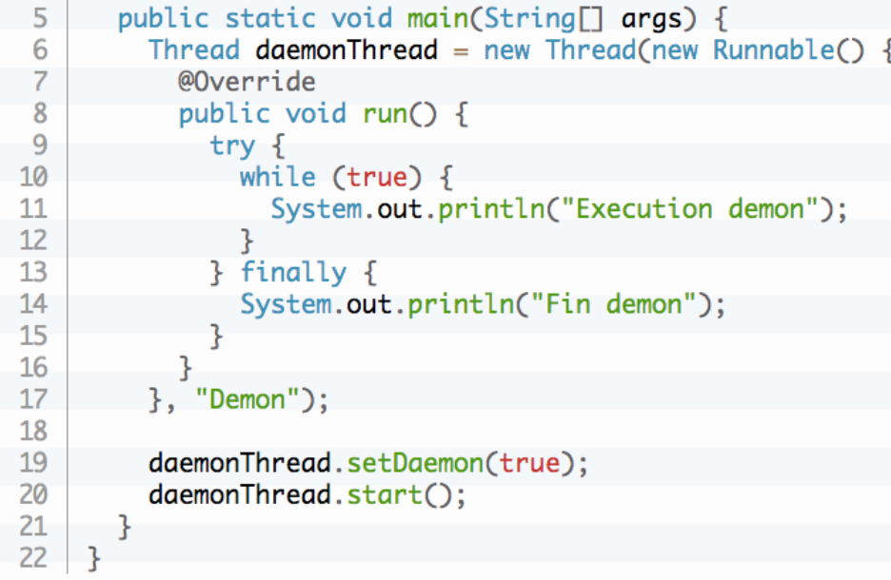
Deamon Threads
There are two categories of threads:
- User thread - high priority.
The JVM waits for a user thread to complete its task before completing it.
- Daemon thread - low priority.
When the JVM stops, the daemon threads are abruptly terminated: their finally blocks are not executed => are not recommended for I/O tasks.
Its role is to provide services to user threads:
- remove of unwanted entries from the cache;
- free the memory of unused objects;
- garbage collection.

Slide 220
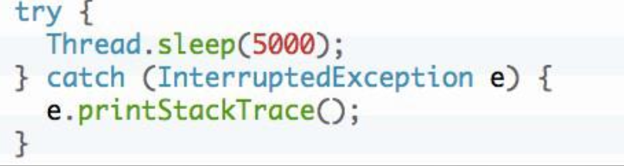
Method sleep
Put the thread to sleep for a certain amount of time (milliseconds).
The static sleep () method is used to put the current thread to sleep for the delay provided as a parameter. It is blocking, it throws an InterruptedException type exception during its execution if another thread requests the interruption of the execution of the thread.

Slide 221
Method join
public class ProducerConsumerTest {
public static void main(String[] args) {
Pool pool = new Pool();
Producer p = new Producer(pool);
Consumer c = new Consumer(pool);
p.start();
c.start();
p.join();
c.join();
System.out.println(“Threads ended!!”);
}
}
Notes:
If our code should wait while a specific thread doesn’t end then it call method “join” on an object that represent the thread.
<number>

Slide 222
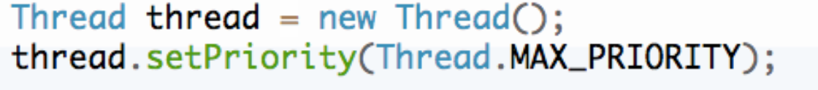
Thread priority
Change the execution priority of the thread.
A thread has a property that specifies its execution priority. To determine or modify the priority of a thread, the Thread class contains the methods: getPriority () and setPriority ().

Slide 223
Method interrupt
Method of class Thread – signalization of interruption
In thread it is inspected whether interruption was signaled:
  static method Thread.interrupted – clear interrupted flags
  instance methods Thread.isInterrupted – doesn’t clear interrupted flag
  InterruptedException is thrown by blocking operations(sleep, wait) – interrupted flag is cleared what exception is caught
Notes:
This method is called on an object that represents a thread that we want to interrupt.
Handling of this method call has to be implemented in source code of specific thread otherwise the thread will not stop.
Executed thread could check if the interruption has been requested by static method Thread.isInterrupted().
<number>

Slide 224
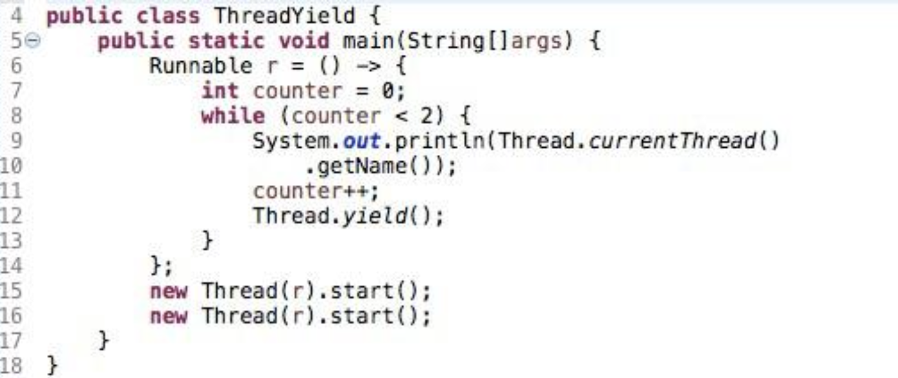
Method yield
Pause a thread to give other threads a chance to run.
The static yield () method provides a mechanism to notify the "scheduler" that the current thread is ready to give up its current CPU usage, but it wants to be scheduled as soon as possible.
Warning: there is no guarantee on the result of invoking this method.

Slide 225
Threads group
The java.lang.ThreadGroup class encapsulates a group of threads:
- It contains a set of threads to make it possible to perform management operations or control over all of these;
- It can also contain other ThreadGroups which then form sub-groups : allows to create a hierarchy in groups.
Note: Once created, a thread cannot be moved to another group.
Some methods:
getName () - Return the name of the group;
ThreadGroup getParent () - Return parent group
setDaemon () - Specify whether the group is a daemon or not;
setMaxPriority () - Specify the maximum priority of the group;
checkAccess () - Check if the current thread has permissions to modify its group; stop (), suspend () .. - identical to the Thread class

Slide 226
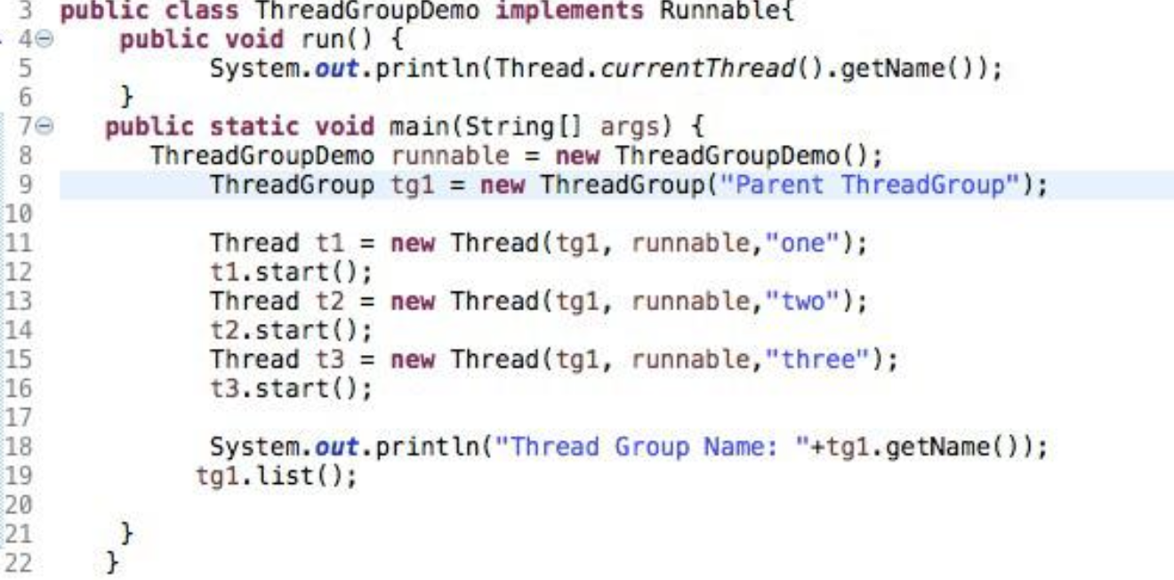
Thread groups
Example:

Slide 227
Synchronization
Since Java is a multithreaded system, care must be taken to prevent multiple threads from modifying objects simultaneously. Section of code that must not be executed simultaneously are known as “critical section”.
Statement synchronized:
synchronized (expression) {
//block or it can be simple statement
}
- expression must resolve to an object
- block is the code of critical section.
The synchronized statement attempts to acquire an exclusive lock for the object or array and it does not execute the critical section code until it can obtain this lock.
Method modifier synchronized indicates that entire method is critical section code. For a synchronized instance method, Java obtains an exclusive lock on the instance. For a synchronized class method, Java obtains an exclusive lock on the class.
Notes:
<number>

Slide 228
Monitor
A monitor is associated with a specific object (or array) and functions as a lock on that object. When a thread holds the monitor for some object, other threads are locked out and cannot inspect or modify this object.
The Java runtime system allows a thread to re-acquire a monitor that it already holds because Java monitors are reentrant. Reentrant monitors are important because they eliminate the possibility of a single thread deadlocking itself on a monitor that it already holds.
class Reentrant {
public synchronized void a() {
b();
System.out.println("here I am, in a()");
}
public synchronized void b() {
System.out.println("here I am, in b()");
}
}
Notes:
<number>

Slide 229
Multiple-Thread Communication
Method wait() of the Object class makes a thread wait until some condition occurs.
Method notify() of the Object class tells a waiting thread that a condition occured.
Notes:
<number>

Slide 230
Example: Producer/Consumer
Intent - the Producer generates an integer between 0 and 9, stores it in a Pool object, and prints the generated number. To make the synchronization problem more interesting, the Producer sleeps for a random amount of time between 0 and 1000 milliseconds before repeating the number generating cycle. The Consumer consumes all integers from the Pool (the exact same object into which the Producer put the integers in the first place) as quickly as they become available.
Notes:
<number>

Slide 231
Producer
public class Producer extends Thread {
private Pool pool;
public Producer(Pool pool) {
this.pool = pool;
}
public void run() {
for (int i = 0; i < 10; i++) {
pool.put(i); // Wait until the previous value is consumed
System.out.println("Producer put: " + i);
try {
Thread.sleep((int)(Math.random() * 1000));
} catch (InterruptedException e) {}
}
}
}
Notes:
<number>

Slide 232
Consumer
public class Consumer extends Thread {
private Pool pool;
public Consumer(Pool pool) {
this.pool = pool;
}
public void run() {
int value;
for (int i = 0; i < 10; i++) {
value = pool.get(); // Wait until the value is produced
System.out.println("Consumer got: " + value);
}
}
}
Notes:
<number>

Slide 233
Shared Pool
public class Pool {
private volatile int contents;
private volatile boolean isFull = false;
public synchronized int get() {
while (! isFull) {
try {
wait();
} catch (InterruptedException e) {}
}
int value = contents;
isFull = false;
notifyAll();
return value;
}
public void put(int i) {
synchronized(this){
while (isFull) {
try {
this.wait();
} catch (InterruptedException e) {}
}
contents = i;
isFull = true;
this.notifyAll();
}
}
}
Notes:
<number>

Slide 234
Producer/Consumer Test
public class ProducerConsumerTest {
public static void main(String[] args) {
Pool pool = new Pool();
Producer p = new Producer(pool);
Consumer c = new Consumer(pool);
p.start();
c.start();
}
}
Notes:
<number>

Slide 235
8th lecture
GUI in Java
JavaFX

Slide 236
Exploring Java GUI Libraries
AWT (Abstract Window Toolkit):
First Java GUI toolkit, introduced in 1995
Basic set of GUI components for simple applications
Uses system components, which limits its portability
Swing:
Developed in response to AWT's limitations, introduced in 1998
Offers a richer set of widgets and components
Platform-independent, allows for a more consistent look across systems
Implements MVC (Model-View-Controller) architecture
JavaFX:
A more modern approach to GUI, introduced in 2008
Supports multimedia, web content, and rich graphics
Intuitive Scene Builder tool for layout design
Strong data binding capabilities and animation support

Slide 237
JavaFX
Introduction
Creating JavaFX program
Root Node
Scene Graph, Scene, Stage
Color
Shapes
Graphics
Audio
Mouse Events

Slide 238
JavaFX
software platform for UI of desktop applications
initial release – 4.12.2008
last stable – 13. 9. 2023
MVC:
  View defined in XML (named FXML) or programming language
  Model, Controller – defined in programming language (compiled to Java byte code)
declared as replacement of the Swing library
could be embedded into AWT/Swing applications
support moved to Gluon company
could be used for cross-platform mobile development

Slide 239
JavaFX
Introduction
Creating JavaFX program
Root Node
Scene Graph, Scene, Stage
Color
Shapes
Graphics
Audio
Mouse Events

Slide 240
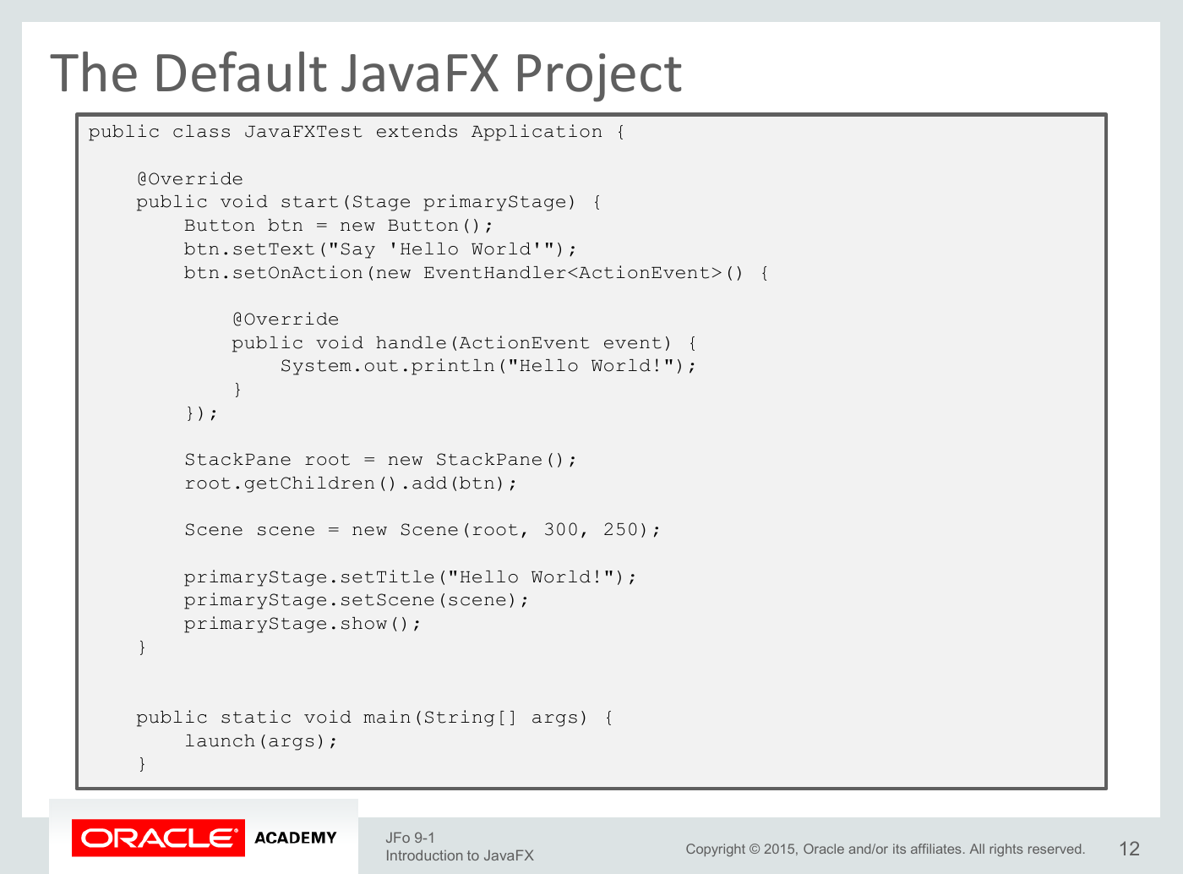

Slide 241
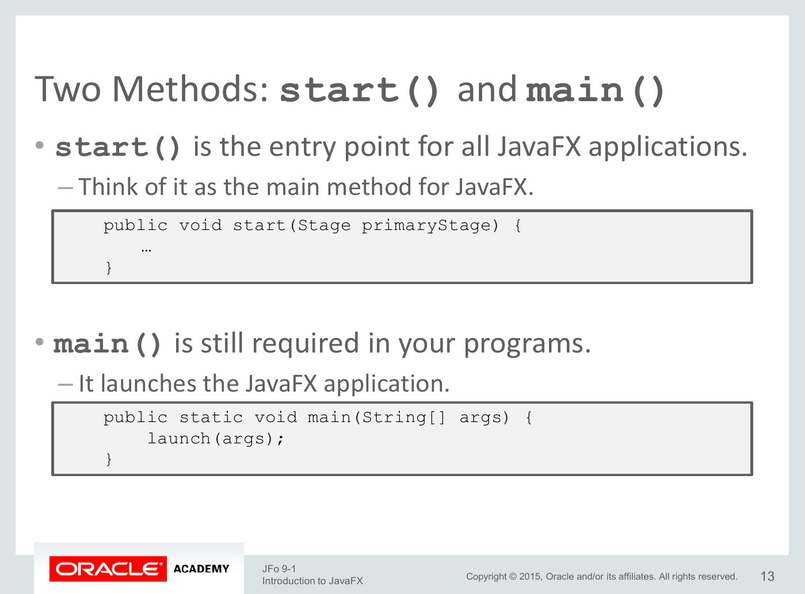

Slide 242
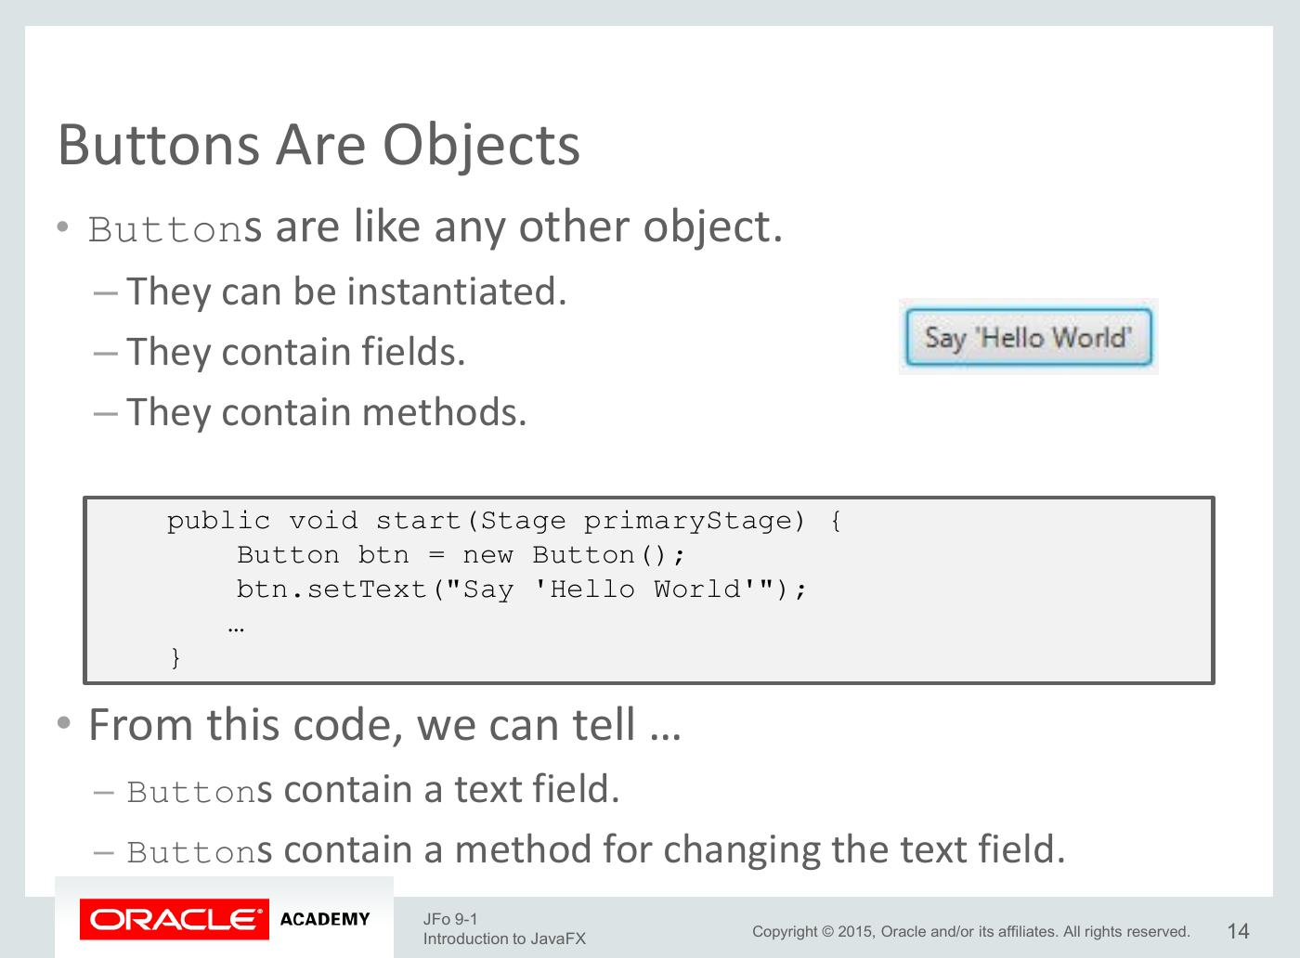

Slide 243
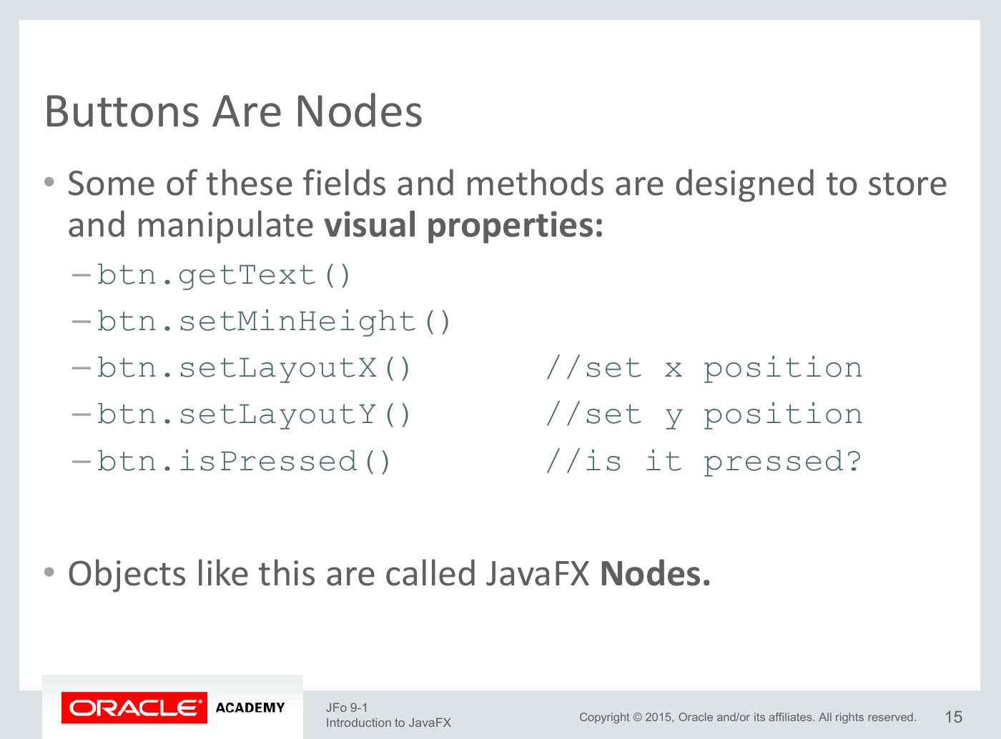

Slide 244
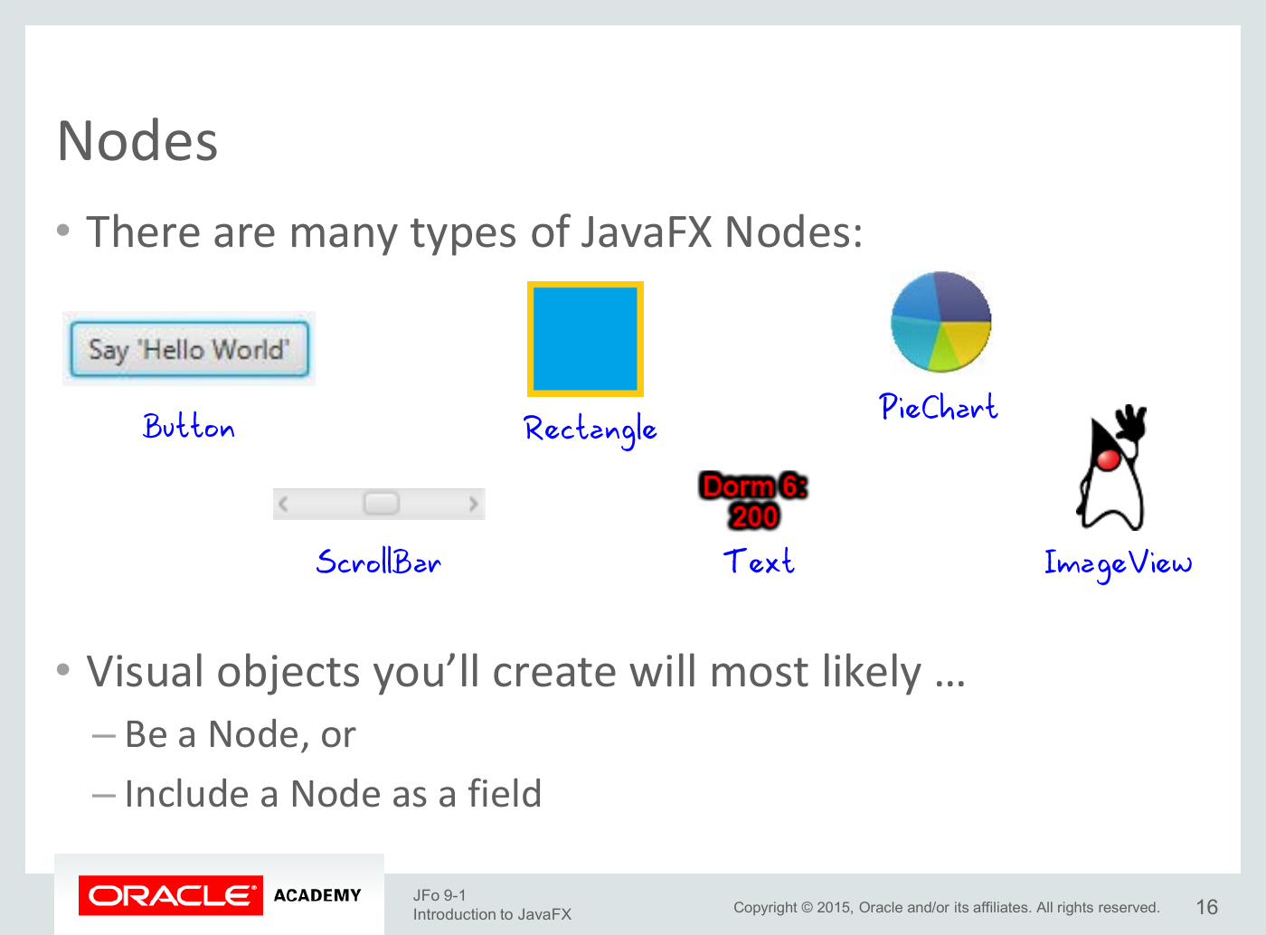

Slide 245
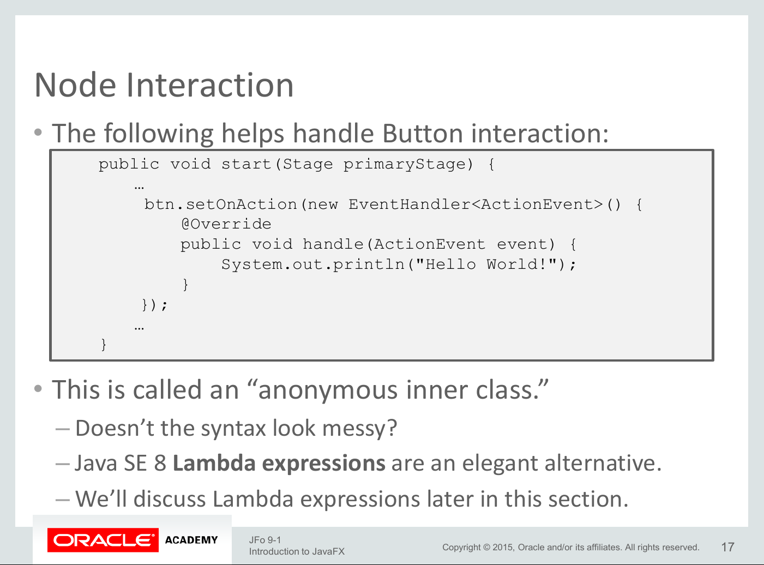

Slide 246
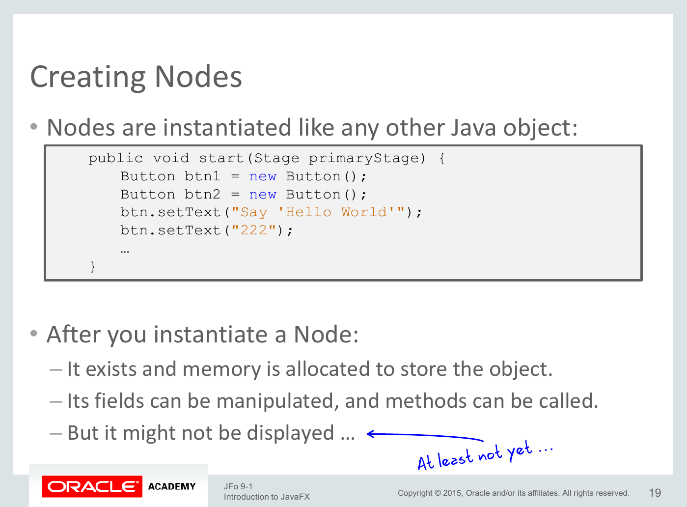

Slide 247
JavaFX
Introduction
Creating JavaFX program
Root Node
Scene Graph, Scene, Stage
Color
Shapes
Graphics
Audio
Mouse Events

Slide 248
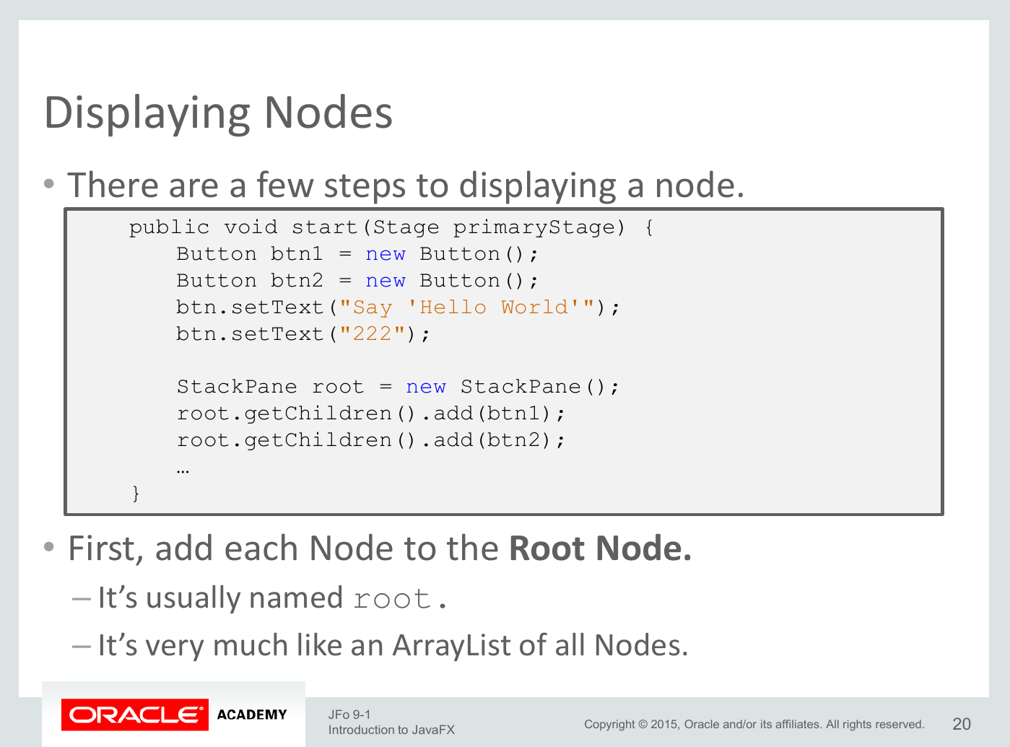

Slide 249
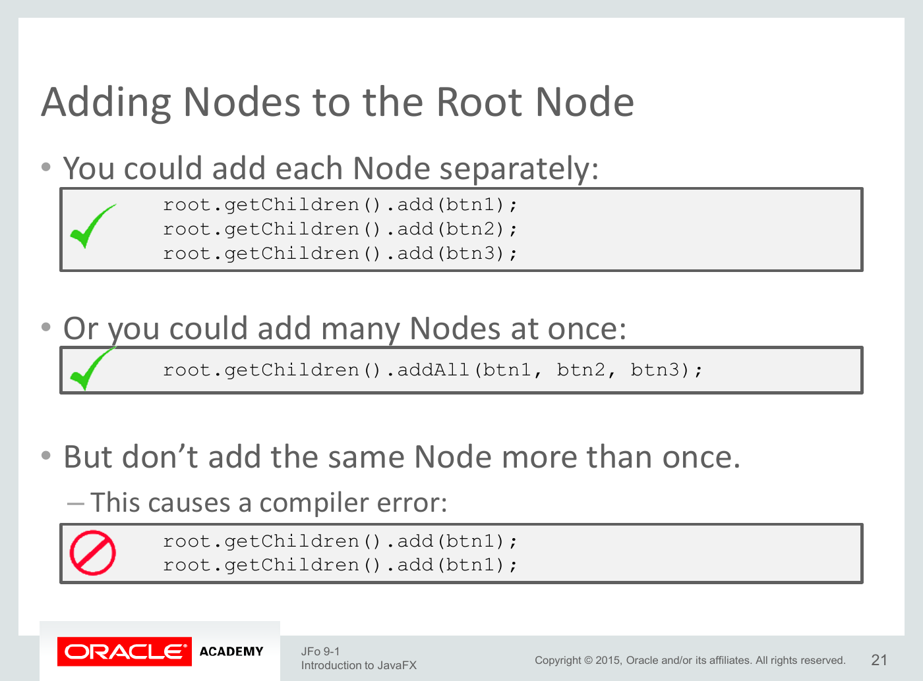

Slide 250
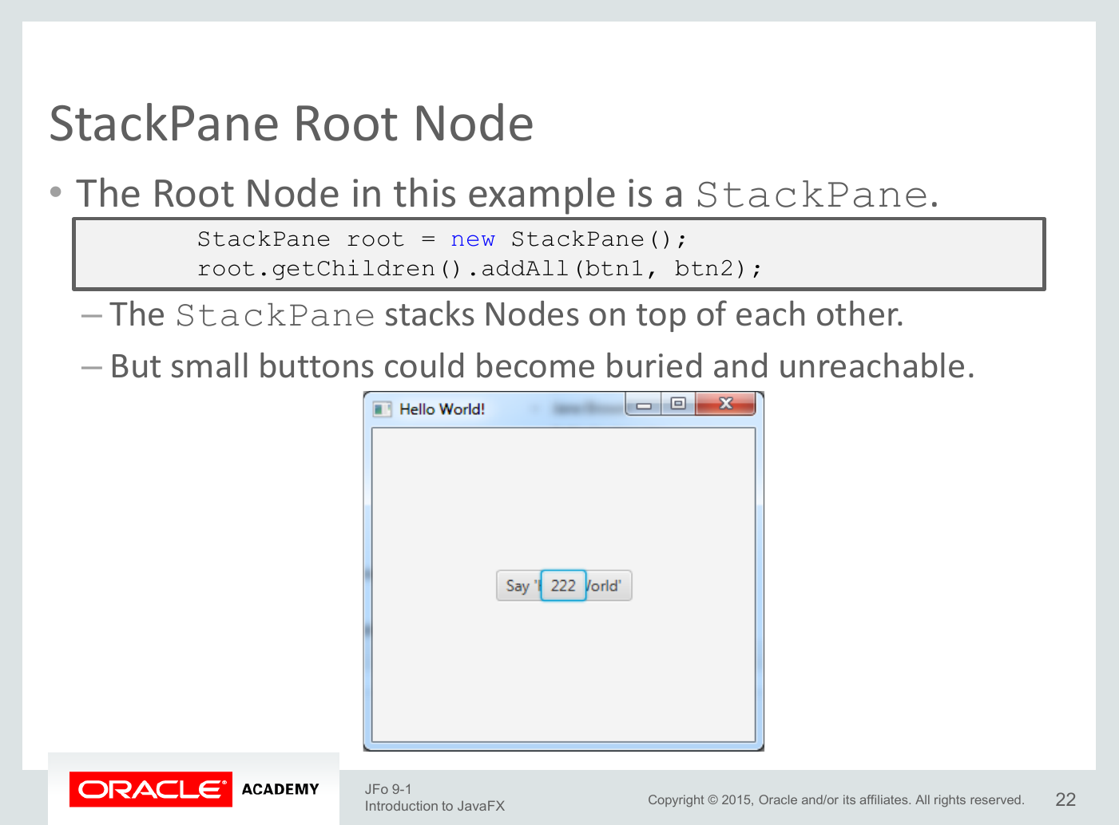

Slide 251
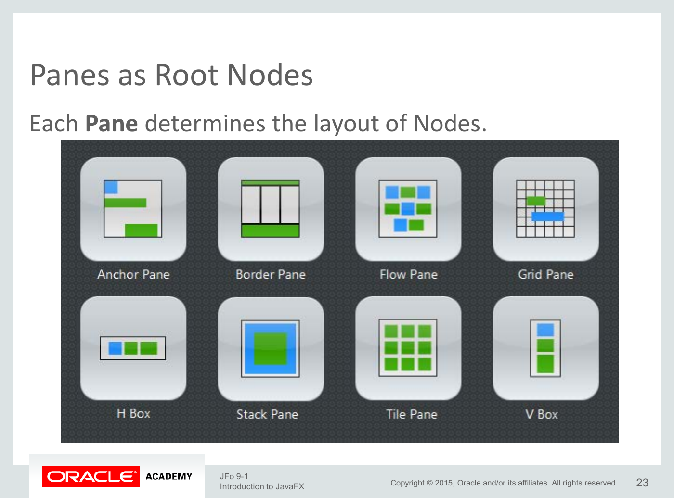

Slide 252
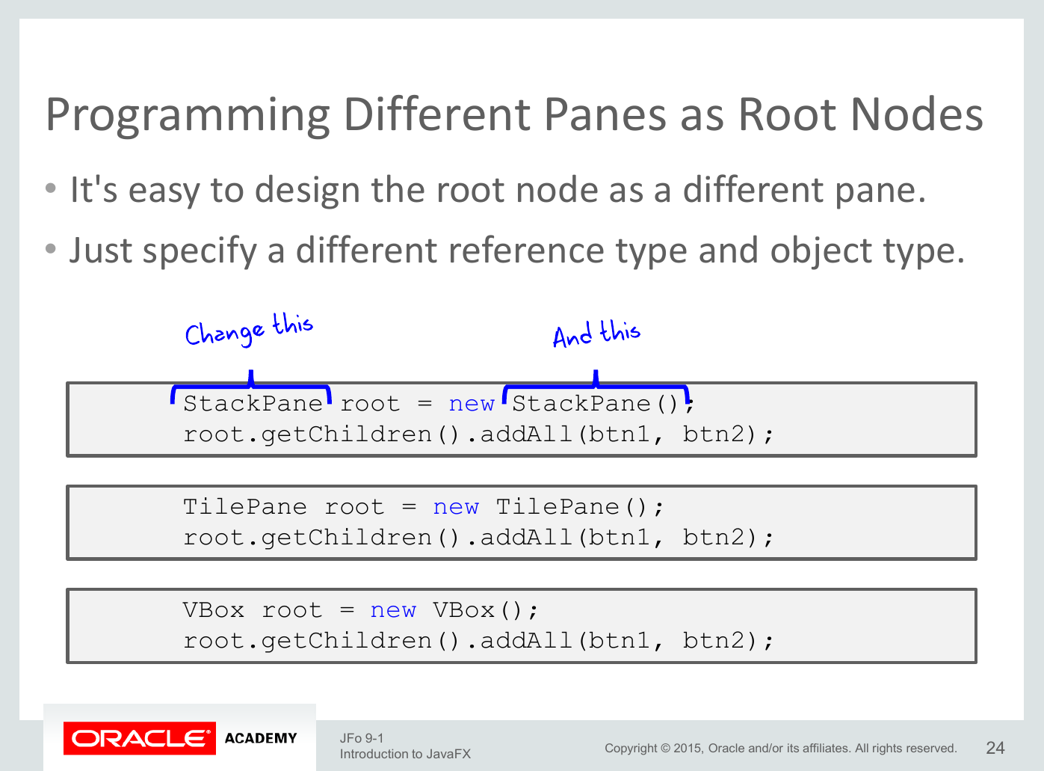

Slide 253
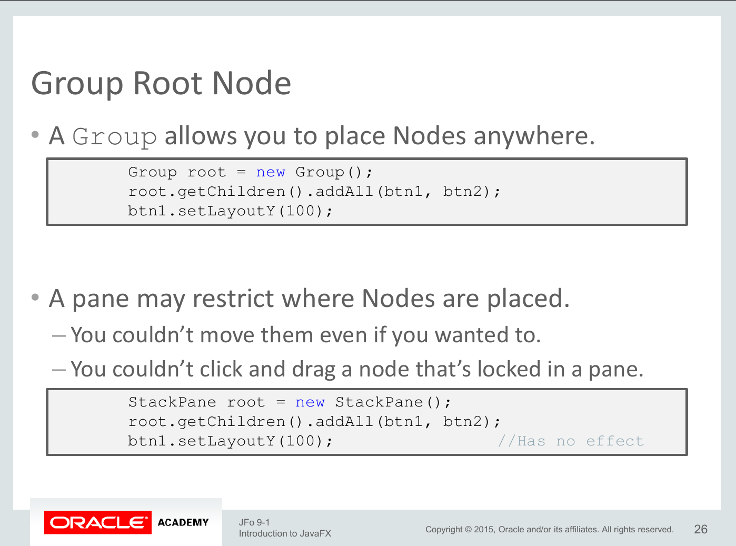

Slide 254
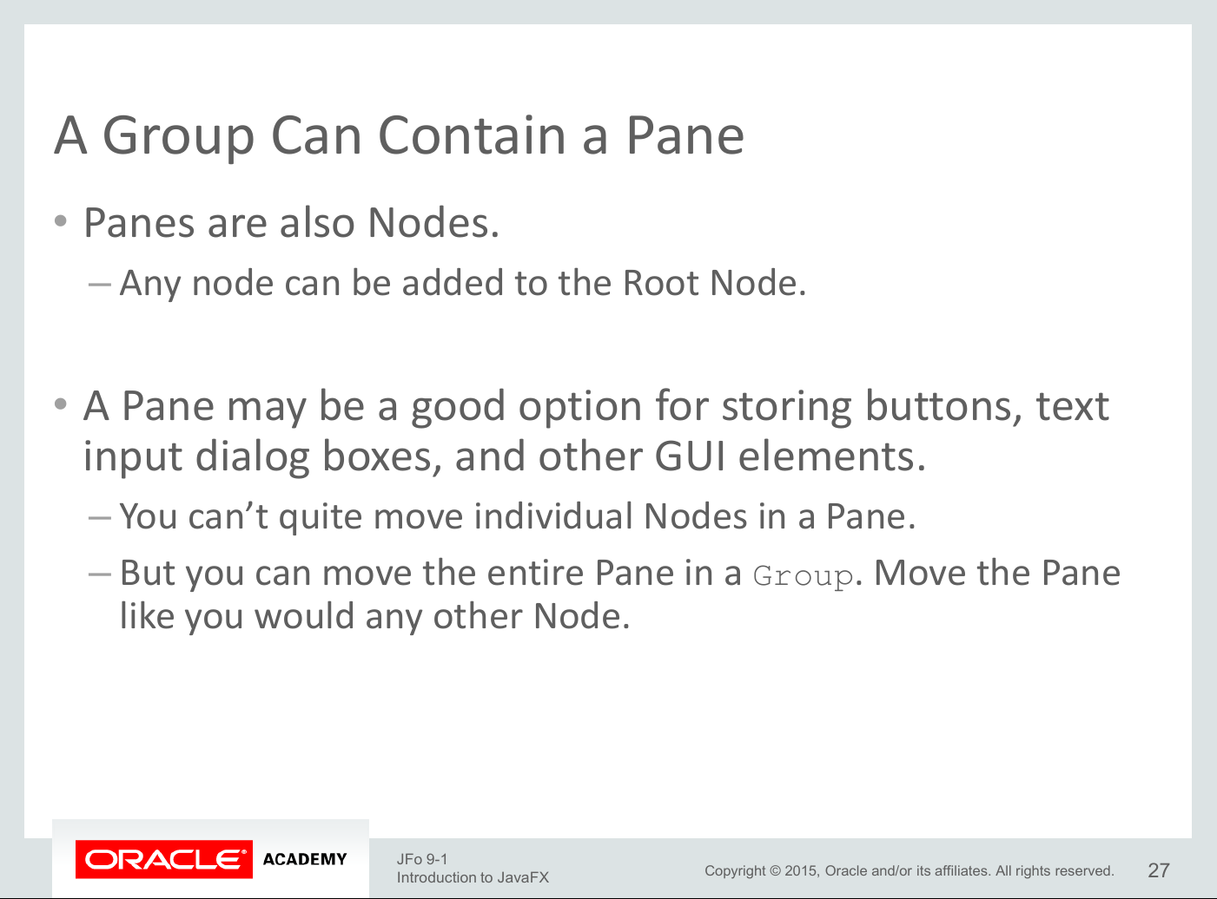

Slide 255
JavaFX
Introduction
Creating JavaFX program
Root Node
Scene Graph, Scene, Stage
Color
Shapes
Graphics
Audio
Mouse Events

Slide 256


Slide 257


Slide 258


Slide 259


Slide 260


Slide 261


Slide 262


Slide 263


Slide 264
JavaFX
Introduction
Creating JavaFX program
Root Node
Scene Graph, Scene, Stage
Color
Shapes
Graphics
Audio
Mouse Events

Slide 265


Slide 266


Slide 267


Slide 268


Slide 269


Slide 270


Slide 271


Slide 272
JavaFX
Introduction
Creating JavaFX program
Root Node
Scene Graph, Scene, Stage
Color
Shapes
Graphics
Audio
Mouse Events

Slide 273


Slide 274


Slide 275


Slide 276


Slide 277


Slide 278


Slide 279


Slide 280


Slide 281
JavaFX
Introduction
Creating JavaFX program
Root Node
Scene Graph, Scene, Stage
Color
Shapes
Graphics
Audio
Mouse Events

Slide 282


Slide 283


Slide 284


Slide 285


Slide 286


Slide 287


Slide 288


Slide 289


Slide 290


Slide 291
JavaFX
Introduction
Creating JavaFX program
Root Node
Scene Graph, Scene, Stage
Color
Shapes
Graphics
Audio
Mouse Events

Slide 292


Slide 293


Slide 294
JavaFX
Introduction
Creating JavaFX program
Root Node
Scene Graph, Scene, Stage
Color
Shapes
Graphics
Audio
Mouse Events

Slide 295


Slide 296


Slide 297


Slide 298


Slide 299


Slide 300


